Slide 1

Additional Cost of Teaching (ACT)
Release Notes – Initial Release (MVP)
Goal
To create a system to submit Medical ACT bid applications and show the decisions applied.
Initial Release
Health Board user role
Regional Co-ordinator user role
Create bid form
Health Board user bid table
Bid status and alerts

Slide 2
Contents
Content | Page
Roles | 3
Accessing Medical ACT APP | 4
Landing Page Overview | 5-7
View a Bid | 18-20
Create a Bid | 21-33
Edit a Bid | 35-37
Withdraw a Bid | 38-41
Download Bids | 42-50
Troubleshooting | 51-52

Slide 3

Roles and functionality overview
Health Board User
View bids
Create bid
Save bid as draft
Edit draft bid
Withdraw bid (in draft only)
Submit bid
Download bids
Regional Co-ordinator
View bids
Create bid
Save bid as draft
Edit draft bid
Withdraw bid (in draft only)
Submit bid
Download bids
Contents Page

Slide 4
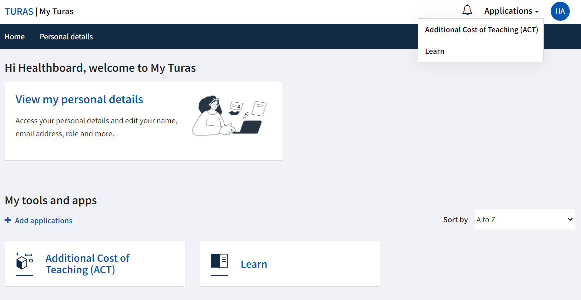
Accessing Medical ACT APP
Users should access their Turas Dashboard (https://turasdashboard.nes.nhs.scot/) using the same login details as they use for other Turas applications i.e. Turas Learn.
ACT can be accessed via the Applications dropdown or the ACT tile under “My tools and apps”. If this is not visible, please contact nes.medicalact@nhs.scot and a NES Admin will add you as a user.
Contents Page

Slide 5
ACT Homepage
Contents Page

Slide 6
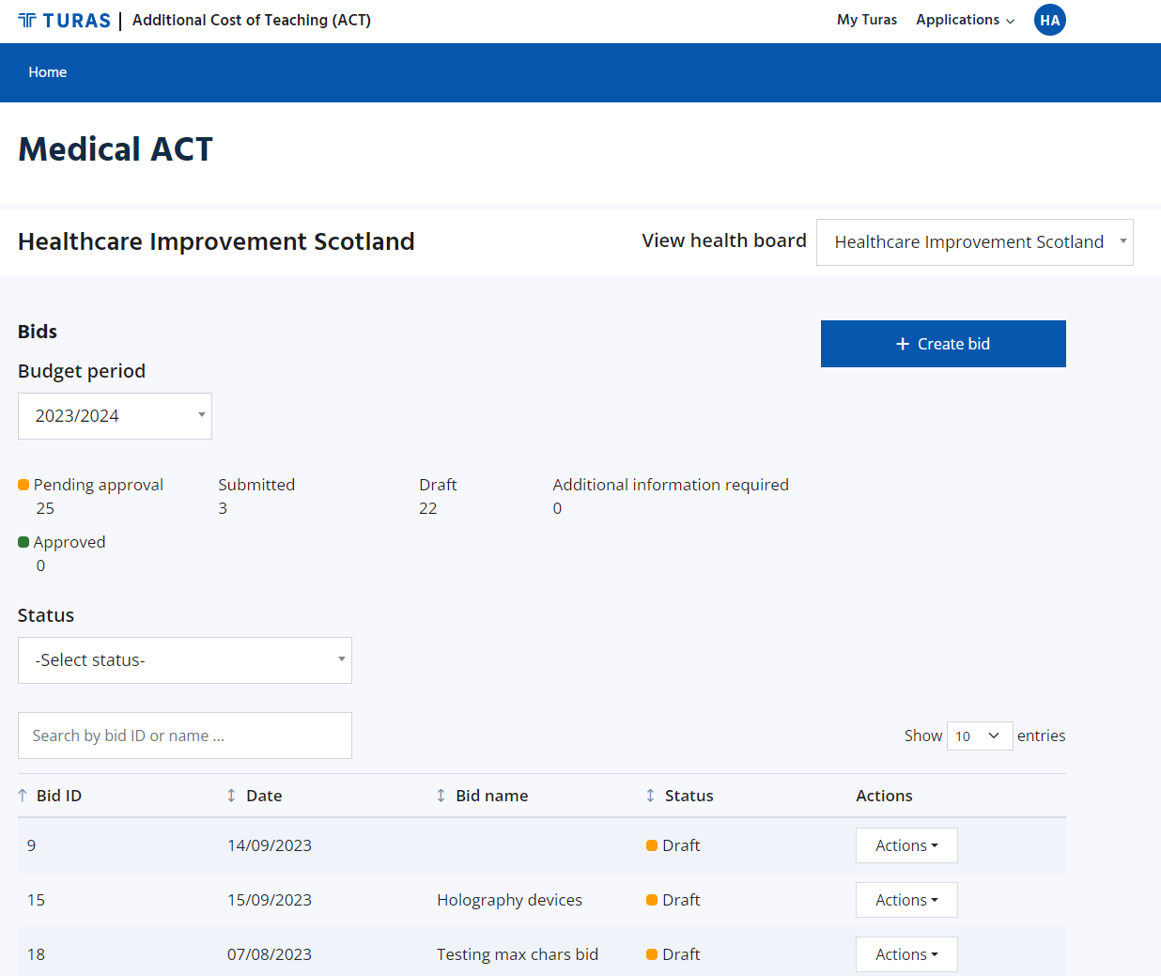
ACT Homepage – Health Board User
When a Health Board user accesses ACT, they will be taken to their ACT Homepage.
They will see the name of the Health Board they are viewing at the top left of the page, a “Create bid” button, and a Bids section (this includes budget period (in financial years), bid status overview, and bid summary table).
For users with multiple Health Boards, they can switch between Health Boards using the “View Health Board” dropdown. Users with only one Health Board will not have the dropdown.
Contents Page

Slide 7
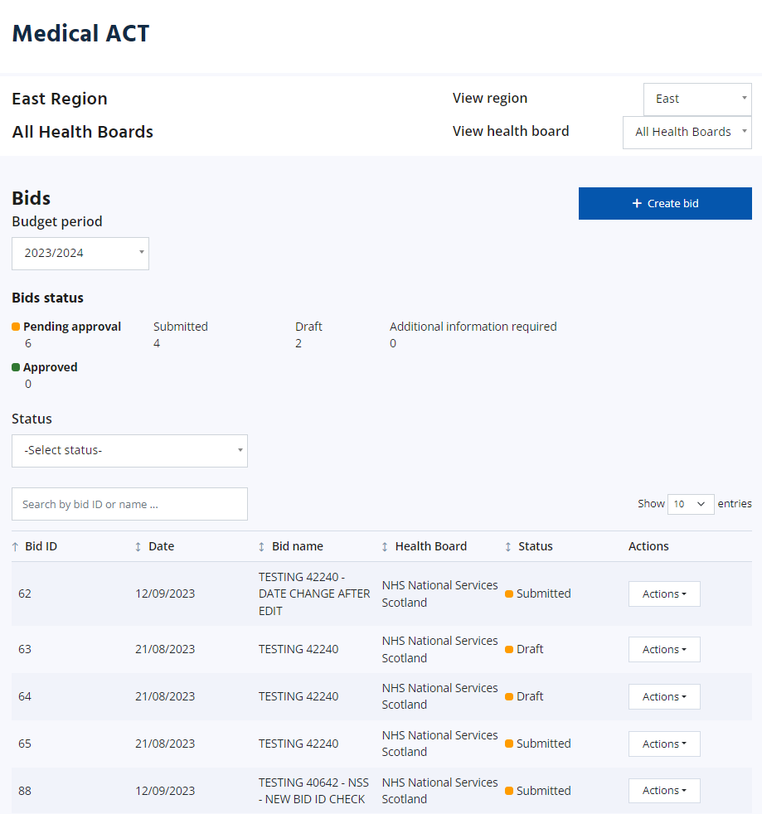
ACT Homepage – Regional Co-ordinator
When a Regional Co-ordinator accesses ACT, they will be taken to their ACT Homepage.
They will see the name of the region they are viewing at the top left of the page, a “Create bid” button, and a Bids section (this includes budget period (financial year), bid status overview, and bid summary table).
For users with multiple regions, they can switch between regions using the “View region” dropdown. This will display all bids within that region.
Within some regions, the user will see a “View Health Board” dropdown. This can be used to display bids for a specific Health Board.
Contents Page

Slide 8
Bids Section Overview
Applicable roles:
All
Contents Page

Slide 9
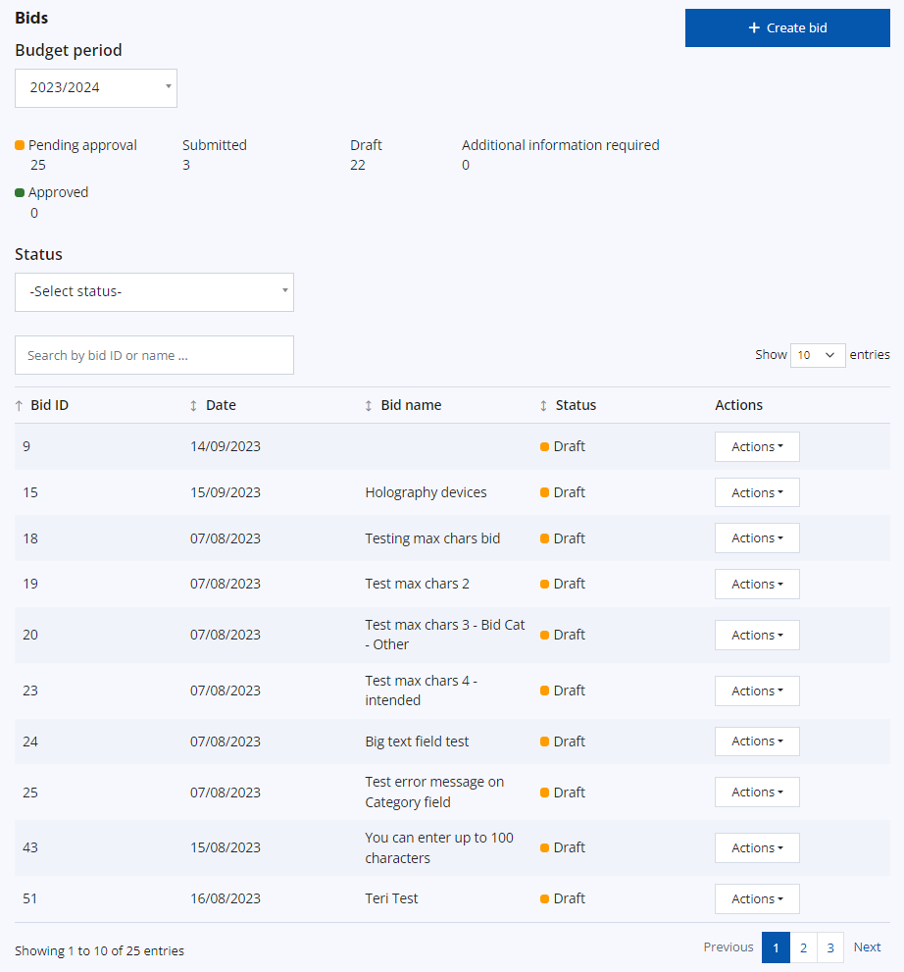
Bids summary table - overview
Contents Page
The bid summary table displays all bids within the selected budget period. The numbers of bids pending approval and bids approved are reflected in the summary table.
The summary table has the following headings:
Bid ID – sequential number ID created by the system once a bid form has been saved as a draft or submitted. The bid ID sequence is not specific to each Health Board and relates to bids created across the whole ACT application.
Date – the date displayed will relate to the date of each status change. The date format is DD/MM/YYYY.
Bid Name – taken from the “Bid name” field when the bid form is created
Health Board – only visible for Regional Co-ordinator and Regional users; displays the Health Board the bid relates to
Status – the status will be one of the following, along with the corresponding colour code:
  Red – Declined
  Blue – Withdrawn or Expired(if not updated within financial year)
  Green – Approved or Approved with conditions
  Amber – Additional information required, Draft, or Submitted
Actions – a dropdown which enables further action on specific bids e.g., to edit a draft bid, view a bid.

Slide 10
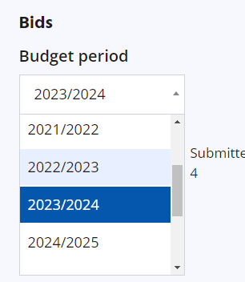
Budget Period
The budget period will default to the current financial year. The dropdown can be used to select a financial year up to 5 years before and up to 5 years after the current year.
The selected year will then determine the information displayed in the statuses and summary table.
Contents Page

Slide 11
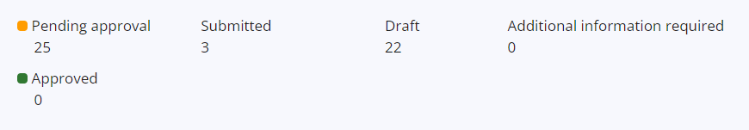
Bids pending approval/approved
A summary of the number of bids pending approval and bids approved is displayed.
Beside bids pending approval, there is a breakdown of statuses – submitted, draft, and additional information required.
Approved bids include those with a status of Approved or Approved with conditions.
Contents Page

Slide 12
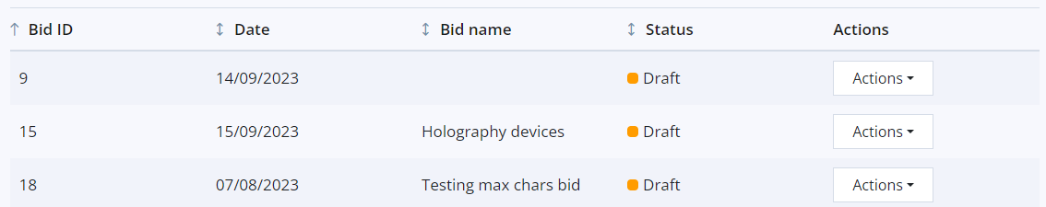
Bids summary table – Bid Order
Bids will default to ascending Bid ID order but can be ordered in ascending or descending order for any of the columns using the arrows beside each heading.
Contents Page

Slide 13
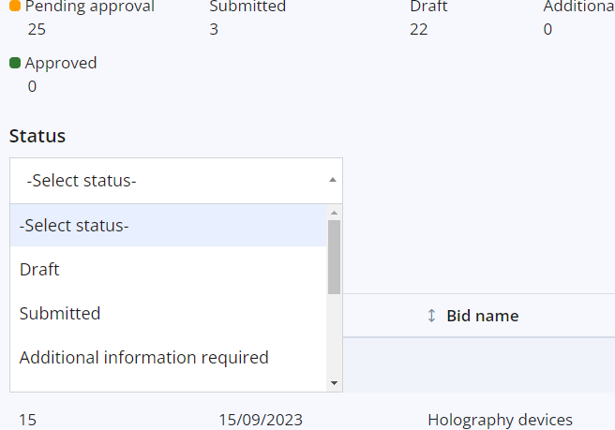
Bids summary table – Filter by status
The “Select status” dropdown can be used to filter displayed bids. Statuses which can be selected include:
Draft
Submitted
Additional information required
Approved
Approved with conditions
Declined
Withdrawn
Expired
Contents Page

Slide 14
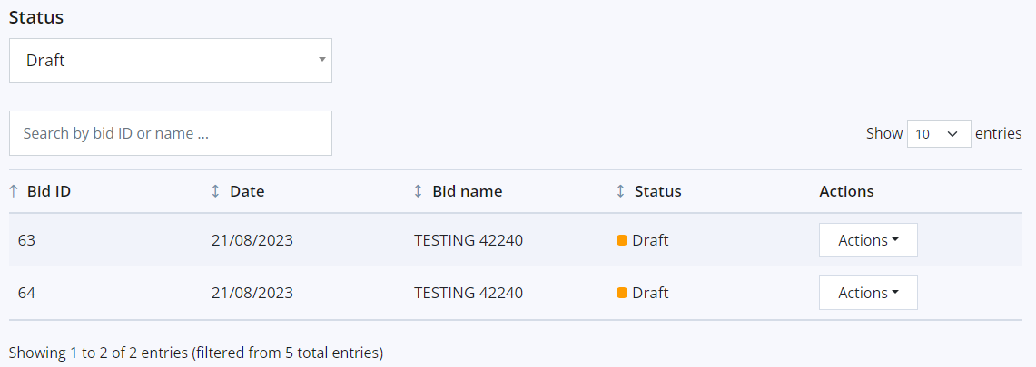
Bids summary table – Filter by status
For example, if Draft is selected, the summary table will only display forms with a status of Draft.
Contents Page

Slide 15
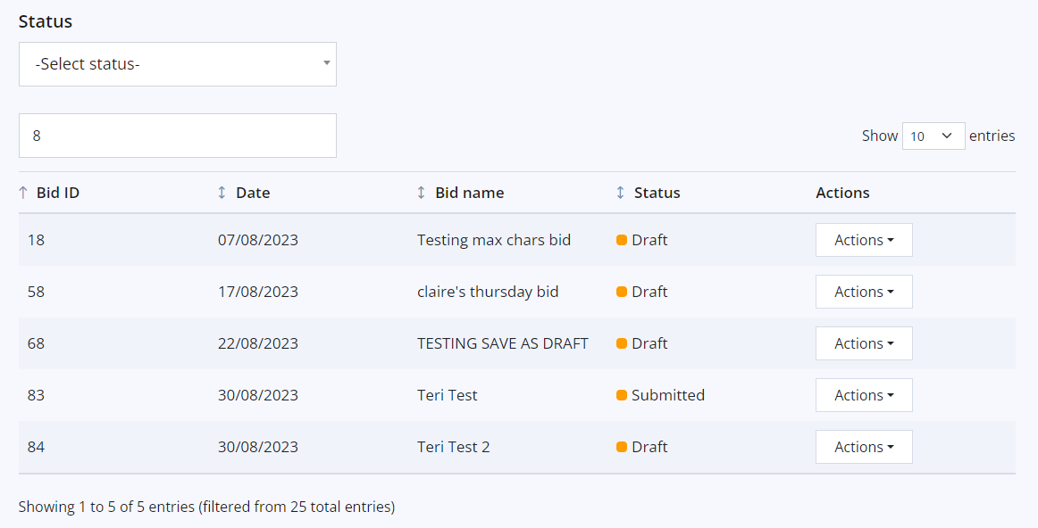
Bids summary table – Filter by search
The search field can be used to filter bids using the Bid ID or Bid Name. Partial input of text will display all bids containing those details. In the below example, “8” has been keyed which returns all bids with “8” in the Bid ID.
Contents Page

Slide 16
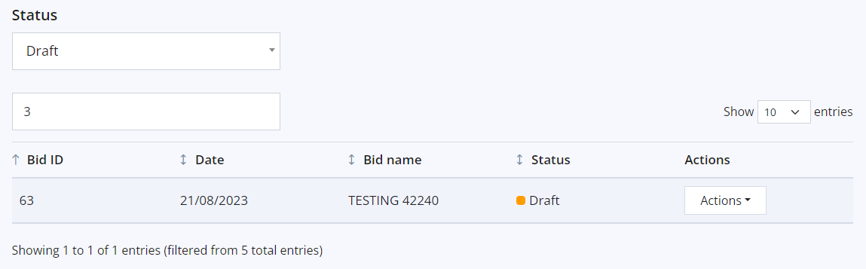
Bids summary table – multiple filters
Filters can be combined if required. In this example, bids have been filtered to show bids with a status of Draft and which have “3” in the Bid ID/Bid name.
Contents Page

Slide 17
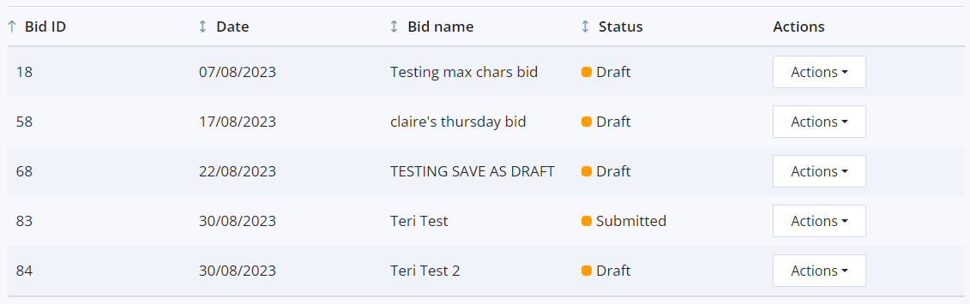
Bids summary table – Actions
The Actions dropdown can be used for various functions, such as viewing, downloading, or editing a bid depending on the user’s role permissions.
Contents Page

Slide 18
View Bid
Applicable roles:
All
Contents Page

Slide 19
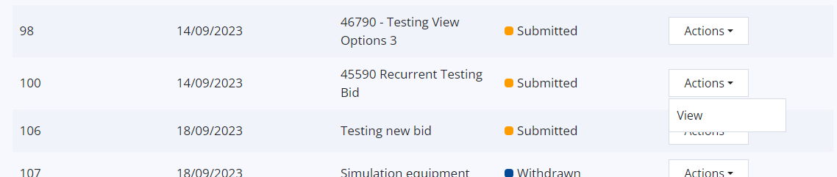
View Bid
The details of any bid can be viewed via the Actions dropdown in the bid summary table:
Contents Page

Slide 20
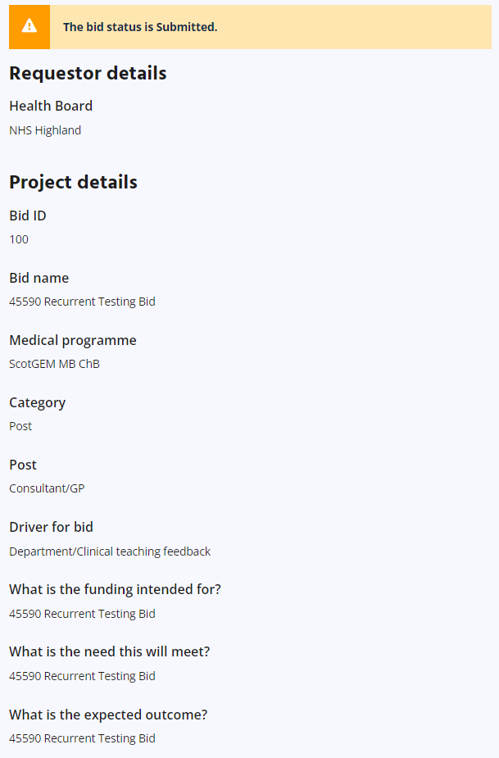
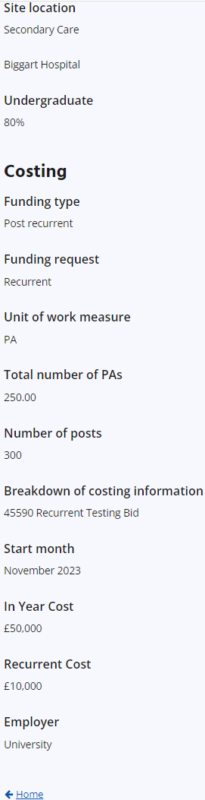
View Bid
The user will be able to see all the details that were inputted when the bid was created.
They can navigate back to the ACT landing page using the “← Home” button at the bottom of the page.
Contents Page

Slide 21
Create Bid
Applicable roles:
Health Board user
Regional Co-ordinator
Contents Page

Slide 22
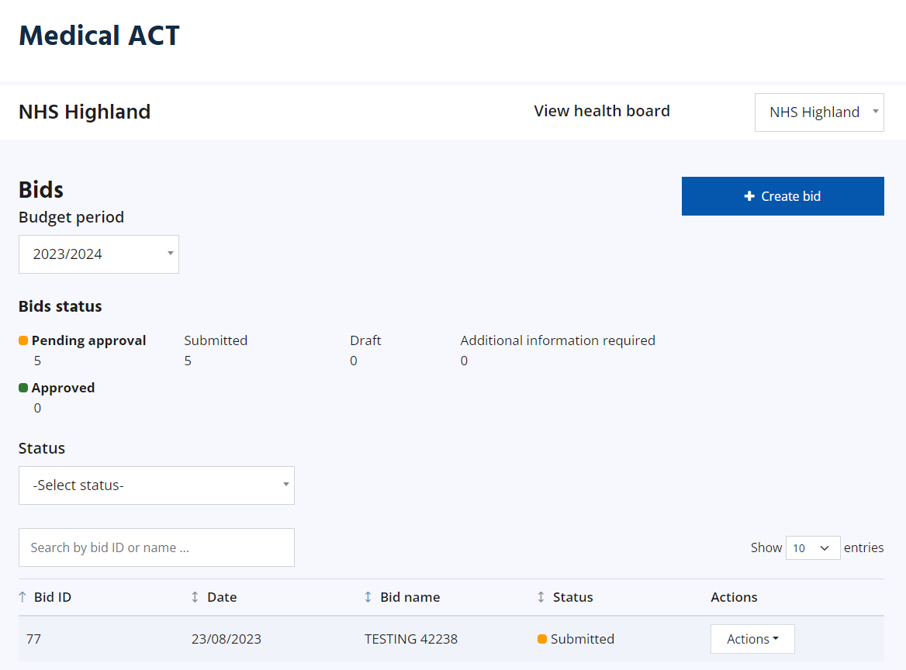
Create Bid
Users can create a bid from the ACT landing page. If the user has multiple Health Boards, they should ensure they are viewing the correct Health Board first, then create the bid.
Contents Page

Slide 23
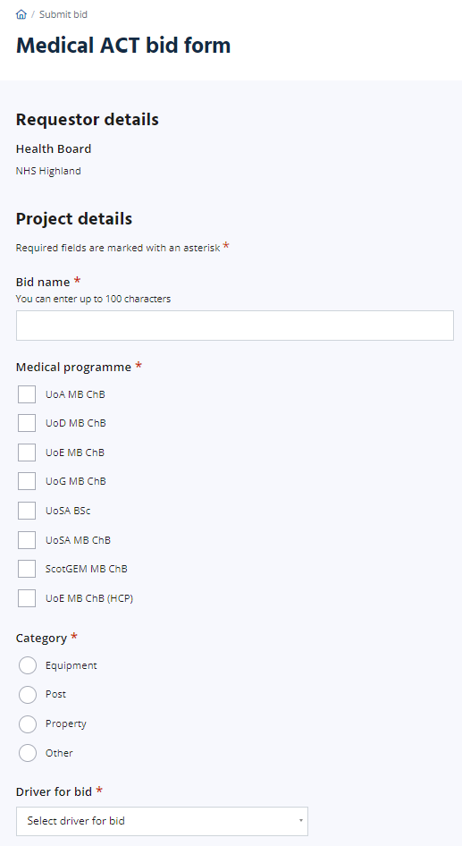
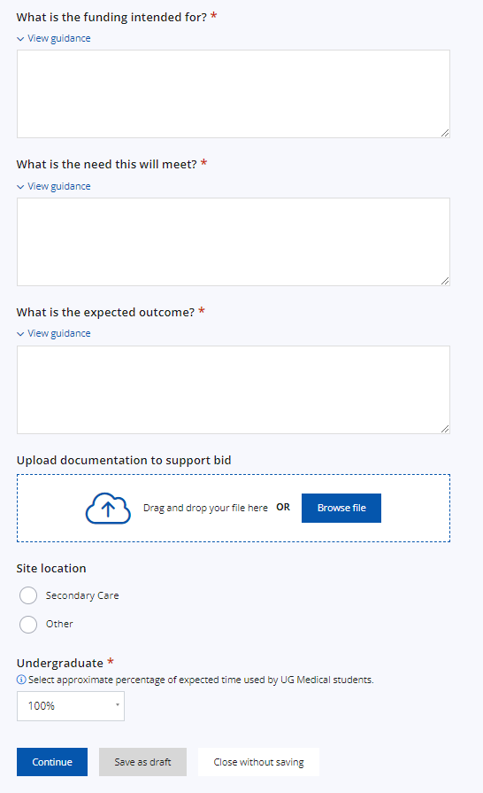
Create Bid – Project Details
The user will be taken to the Medical ACT bid form where they can complete the form with the Project details.
The Driver for bid dropdown gives the following options:
Increase in student numbers
Curriculum changes
Replacement of equipment
Department/Clinical teaching feedback
Student feedback
Student wellbeing
Other (if this is chosen, a free text box will appear)
Once this form is complete, the user can Continue to the Costing page, save the form as draft, or close the form without saving.
Pre-populated based on which Health Board the user was viewing on the homepage.
When Secondary Care is selected, the user will be able to select the location from a dropdown. Where Other is selected, a free text box will appear.
Selecting a category will provide sub-categories to choose from (details on next slide)
Contents Page

Slide 24
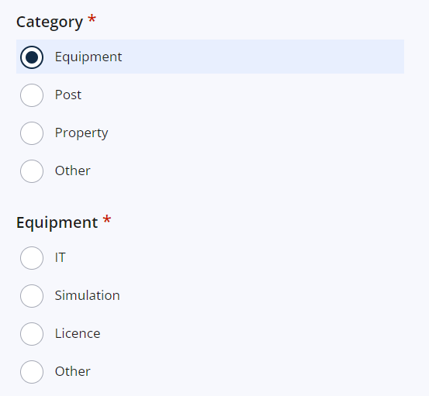
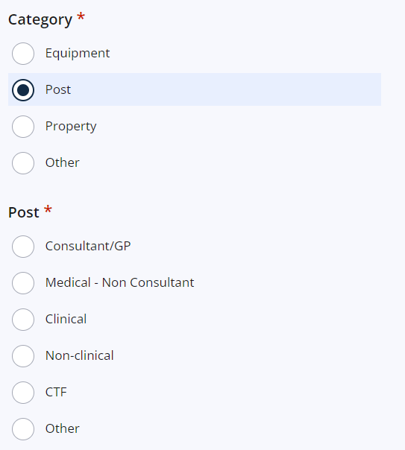
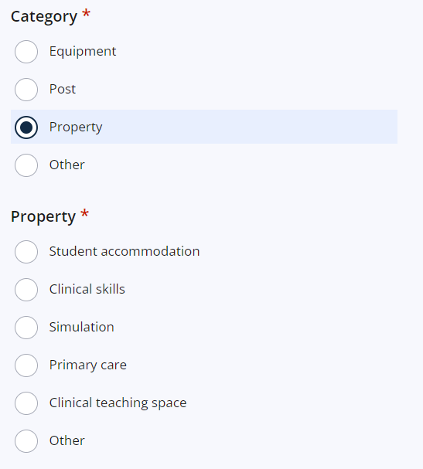
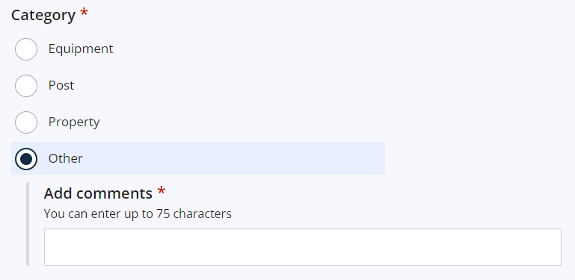
Create Bid – Project Details (Category)
When a Category is chosen, the user will be required to select a sub-category
Contents Page

Slide 25
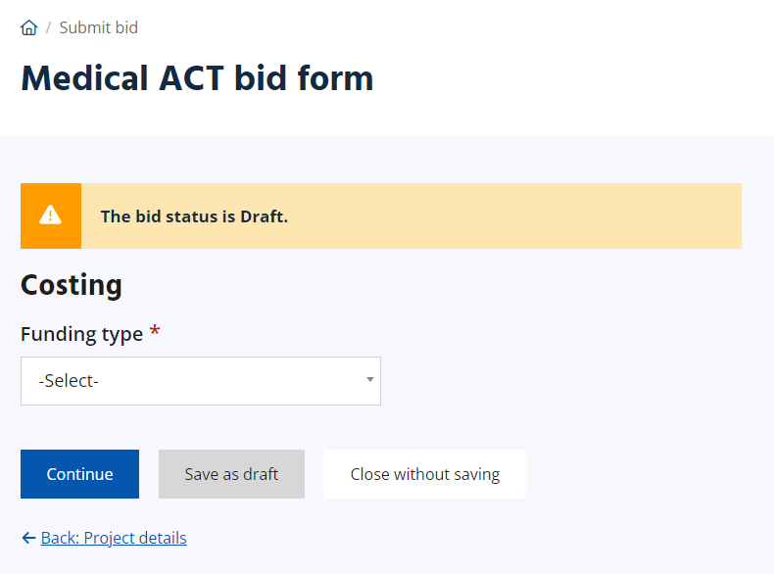
Create Bid – Costing Overview
The Costing page allows the user to select the funding type from the dropdown. The available options are:
Post GP teaching (top sliced)
Post recurrent
Post non recurrent (time limited)
Student T & A
Other recurrent
Other non recurrent (time limited)
If your bid has separate elements with different funding types, separate bids will need to be submitted.
Contents Page

Slide 26
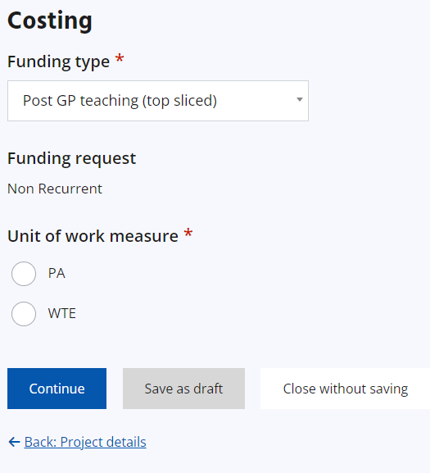
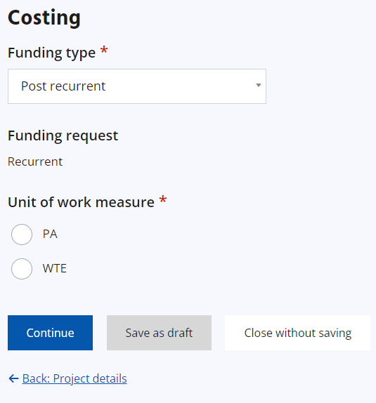
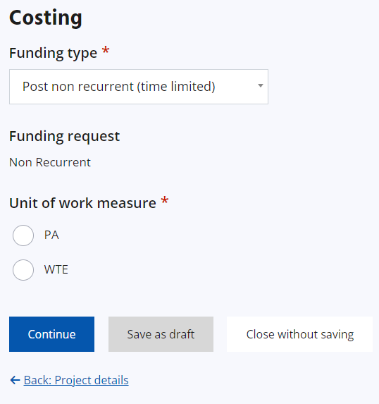
Create Bid – Funding Types
Examples of how the form will look depending on each funding type:
Contents Page

Slide 27
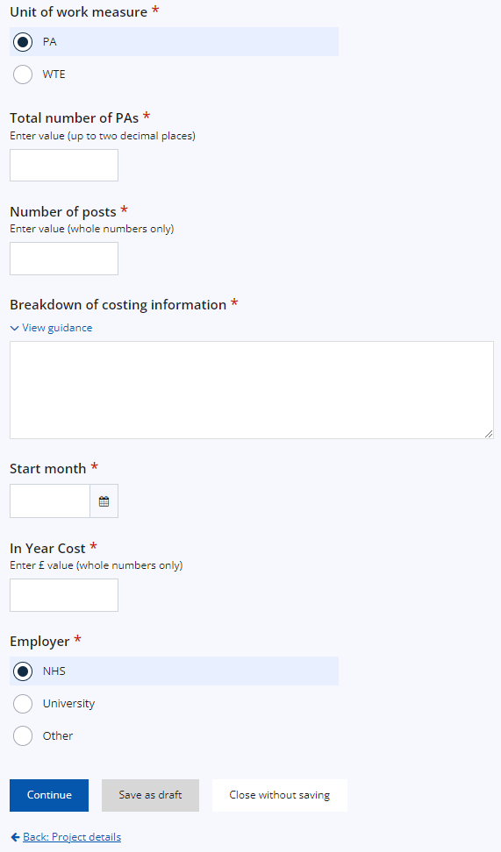

Create Bid – Funding Types
Where PA or WTE is selected for Unit of work measure, more details will be required:
Contents Page

Slide 28
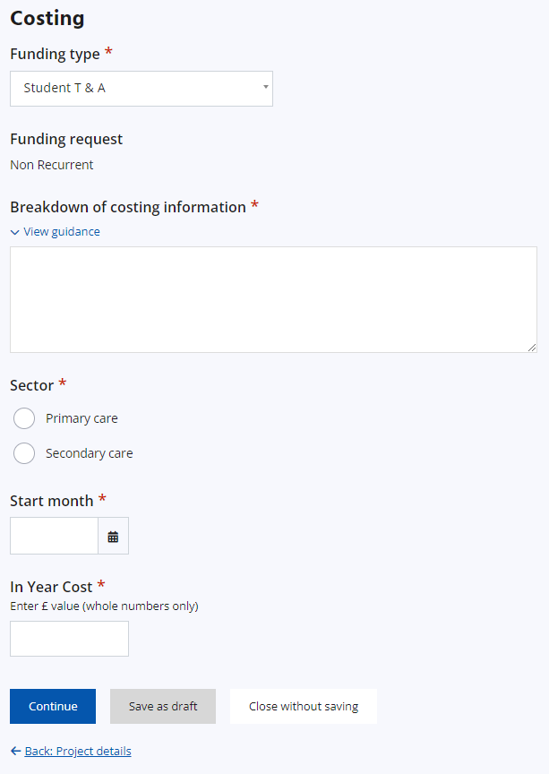
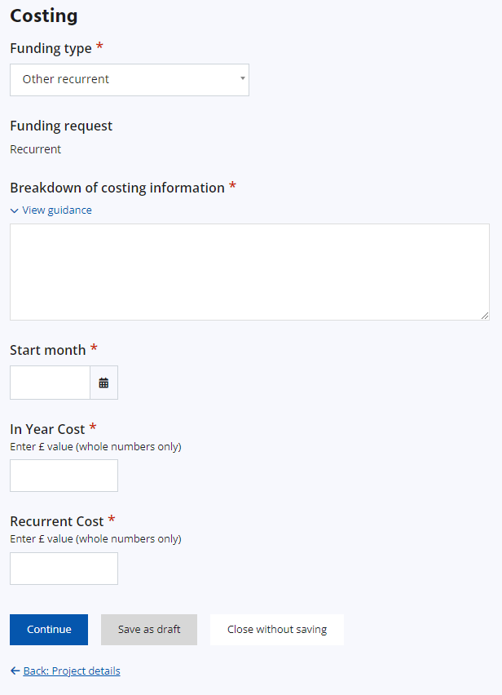
Create Bid – Funding Types
Examples of how the form will look depending on each funding type:
Contents Page

Slide 29
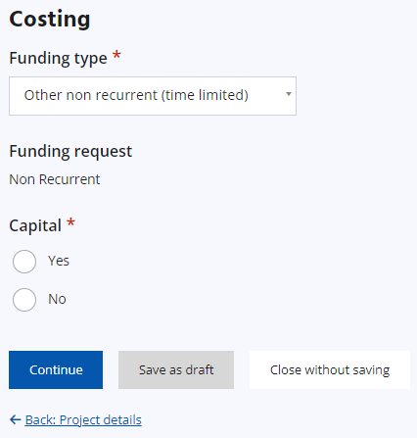
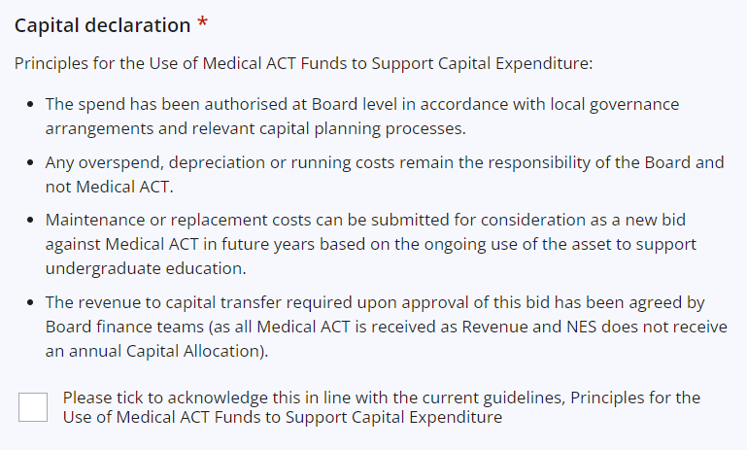
Create Bid – Funding Types
Examples of how the form will look depending on each funding type:
Where Yes is chosen for Capital, a Capital declaration will require acknowledgement at the bottom of the form
Contents Page

Slide 30
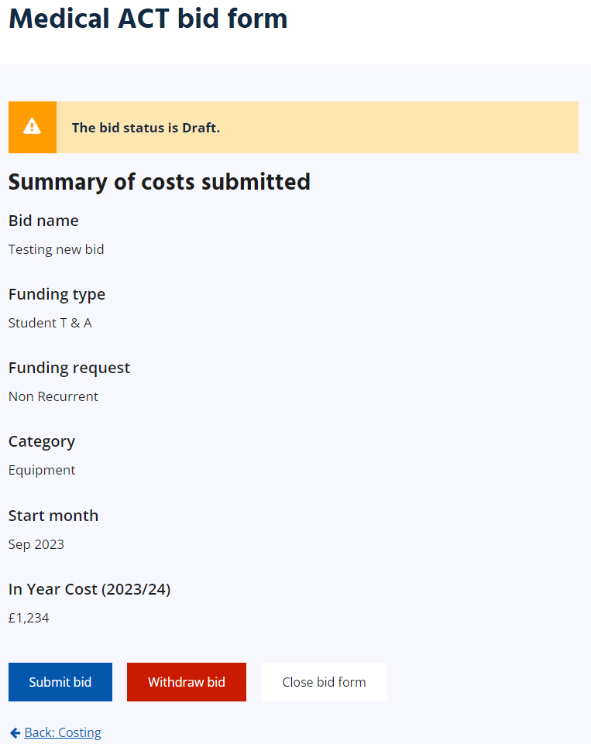
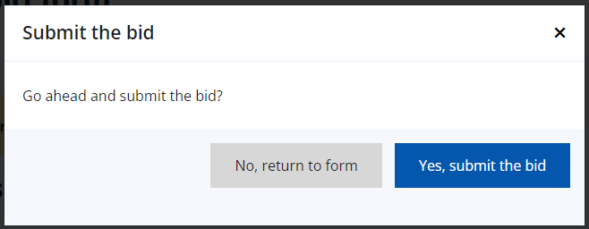
Create Bid – Summary page
Once the costing page is complete, and Continue is selected, the user will be taken to a summary page which gives an overview of the inputted information.
If details need to be amended, the user can use the Back button at the bottom of the page.
The user can then submit the bid if ready, withdraw it, or close the bid form (this will keep it saved as a draft).
On clicking to submit the bid, the user will be asked to confirm submission.
Contents Page

Slide 31
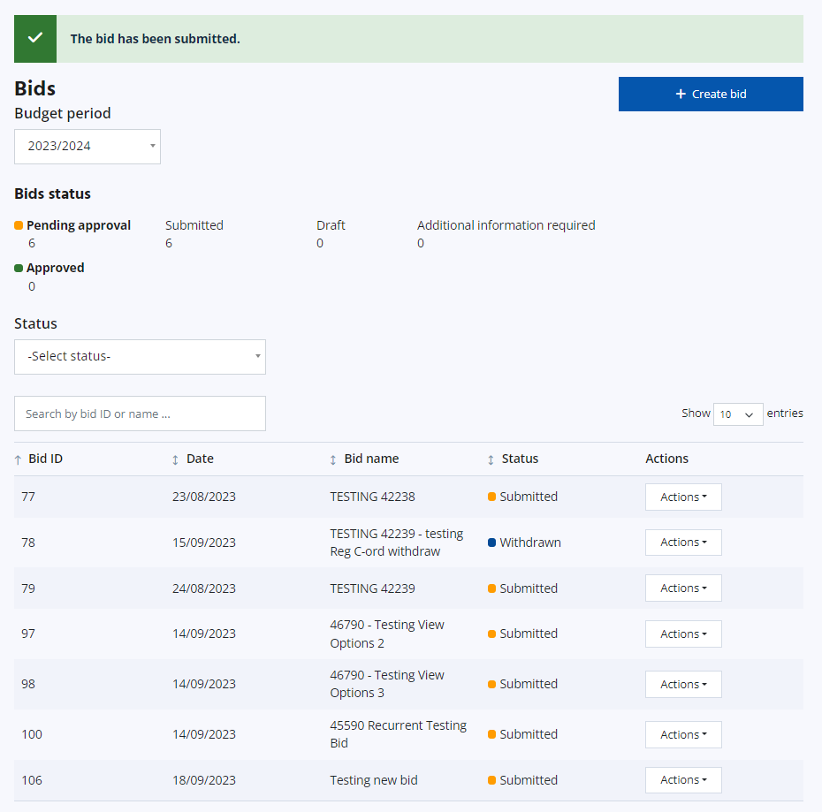
Create Bid –Submitting the bid
The user will be taken back to the landing page where a green alert will confirm the bid has been submitted.
The bid is also now displaying in the bid summary table with an automatically-assigned Bid ID.
Contents Page

Slide 32
Information for Bids
If a field has an Asterix this indicates a mandatory field, and you will not be allowed to submit the bid without completing.
The Reference will be generated by the APP. This is not individual to Health Boards but sequential as bids are submitted and will increase year on year.
Bid Name – 100 characters. If you wish to include a local reference this can be included in the name to allow you to search by it on the landing page.
*What is the funding intended for? (1,000 characters) This should include a concise background and summary of the situation.
*What is the need this will meet? (600 characters) This should highlight the identified gap and how this will be met.
*What is the expected outcome (250 characters) This should include how the bid fulfils the need and details of any evaluation.
Bullet points may be helpful for the above. If the bid is complex additional information can be attached for example a job specification or project plan.
The Site location secondary care has a list taken from the annual Quality Report locations. If you start typing the location a list of options will become available to choose from. NES Admin can add additional locations for future use, please email Medical ACT mailbox.
Primary Care locations can be added by free text
Undergraduate % - increments of 10 – Please pick closest match
Contents Page

Slide 33
Selecting funding Type
If required in future years will spend be included in MoT return as top-sliced cost
Yes
No
Is the cost for student expenses
Is cost recurrent (Permanent funding request)
Yes
No
Yes
No
Student T&A
Post GP teaching
Is it for a post/s
Is it for a post/s
Yes
No
Yes
No
Post recurrent
Other recurrent
Post
non-recurrent
Other
non-recurrent
Contents Page

Slide 34
Information for Bids
In-year cost – cost for the current/first NHS financial year i.e. April-March.
Recurrent bids - the in-year cost might be lower than the recurrent costs as there will only be part-year spending for the first year,
e.g. 1 WTE band 7 clinical skills lead 24/25 only 8 months £48k recurrent amount £72k, £72k will be added to following years baseline position.
Non-recurrent bid – should reflect the current year costs only
Future year cost – only available for non-recurrent bids this allows for multi-year bids to be placed and funding approved
e.g. accommodation block refurb current year £250k, future year 1 £60k
Breakdown of costing 250 characters – this should detail the spend eg 10 laptops at £1000 ea, 5 smart screens £10k ea,
Contents Page

Slide 35
Edit Bid
Applicable roles:
Health Board user
Regional Co-ordinator
Contents Page

Slide 36
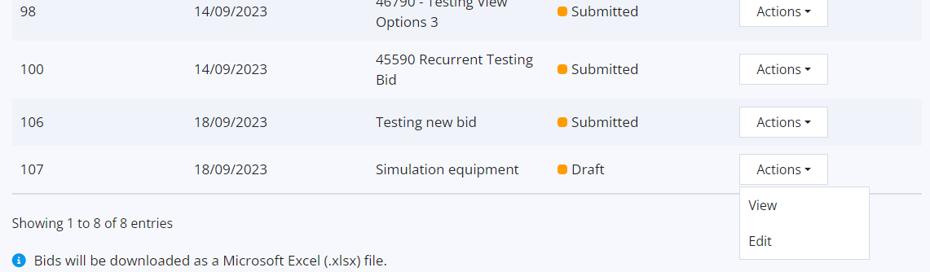
Edit Bid
Bids with a status of Draft can be edited by selecting Edit from the Actions dropdown in the bid summary table.
Contents Page

Slide 37
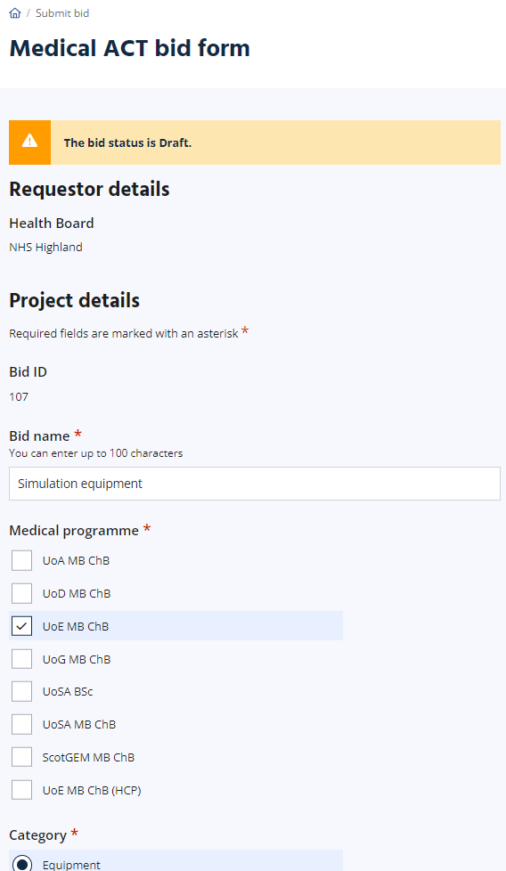
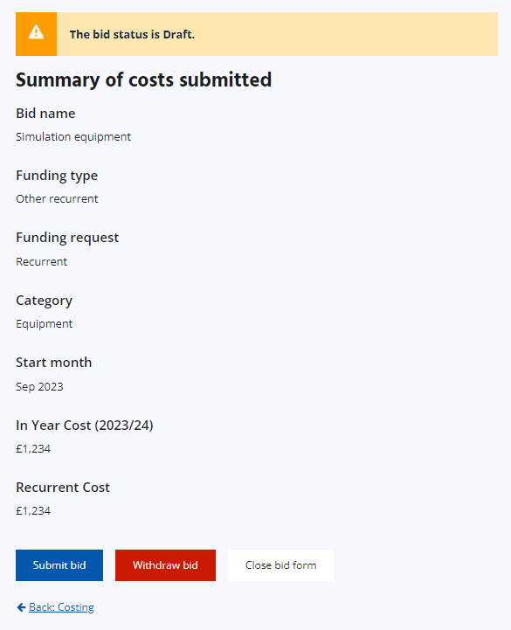
Edit Bid
The user will then be able to update or add details as required, going through the same process as creating a bid i.e. Project details page, costing page, then summary.
From the summary page, they can submit the bid or save it as a draft again.
Contents Page

Slide 38
Withdraw Bid
Applicable roles:
Health Board user – submitted status only
Regional Co-ordinator
Contents Page

Slide 39
Withdraw Bid
Bids with a status of Draft can be withdrawn via the Edit option of the Actions dropdown in the bid summary table:
Contents Page

Slide 40
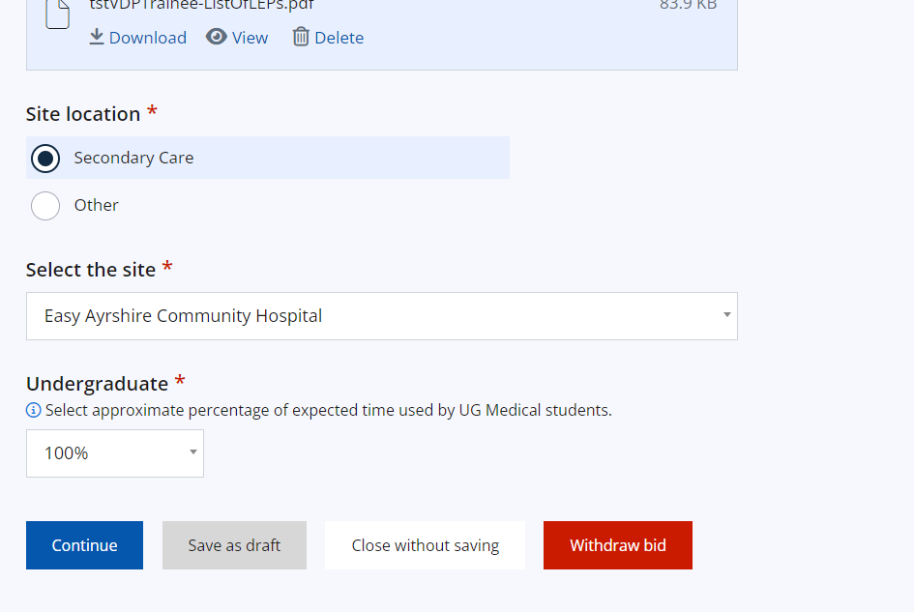
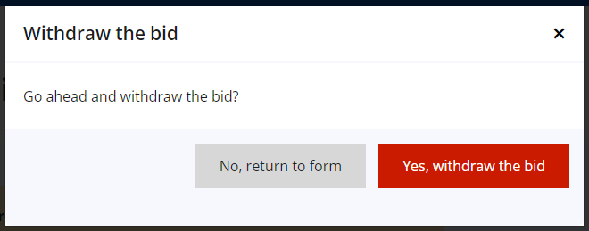
Withdraw Bid
The user is taken to the draft bid form. They can check the details to ensure the correct form is being withdrawn and can select “Withdraw bid” at the bottom of the form.
A modal will request confirmation for the bid to be withdrawn.
Contents Page

Slide 41
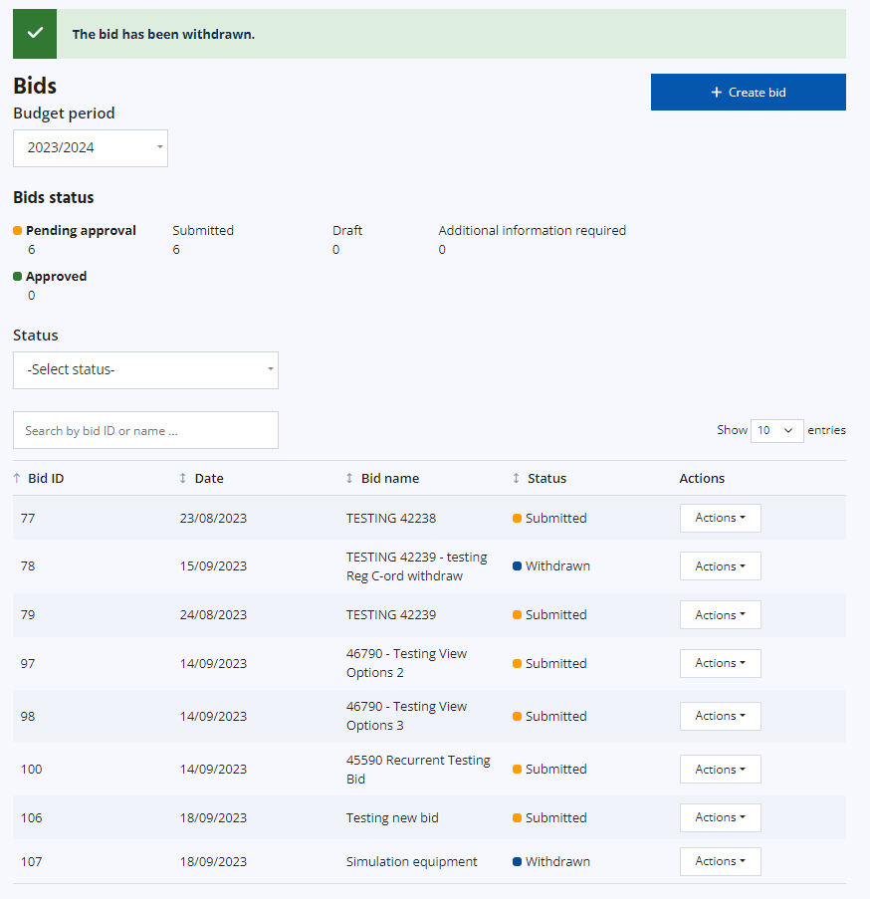
Withdraw Bid
The user will be taken back to the ACT landing page where a green alert will confirm withdrawal of the bid.
The status of the bid will update to Withdrawn in the bid summary table.
Contents Page

Slide 42
Download Filtered Bids
Applicable roles:
All
Contents Page

Slide 43
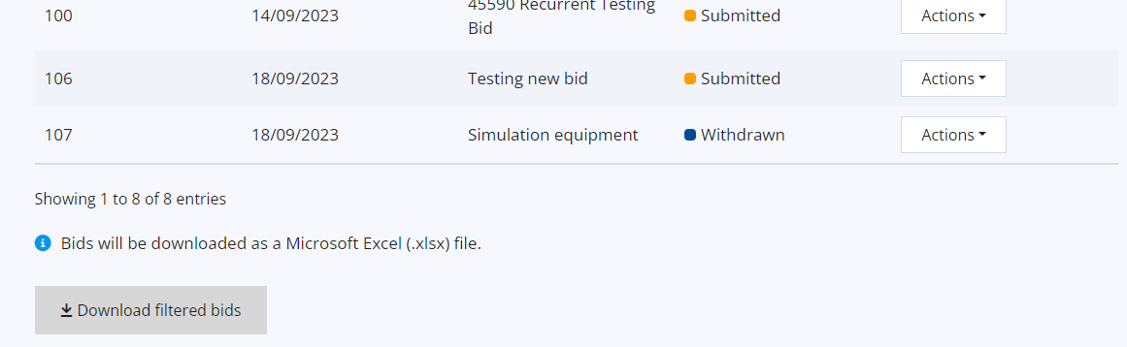
Download Filtered Bids
Details of bids in the summary table can be downloaded in an .xlsx file by using the “Download filtered bids” button below the summary table.
Contents Page

Slide 44
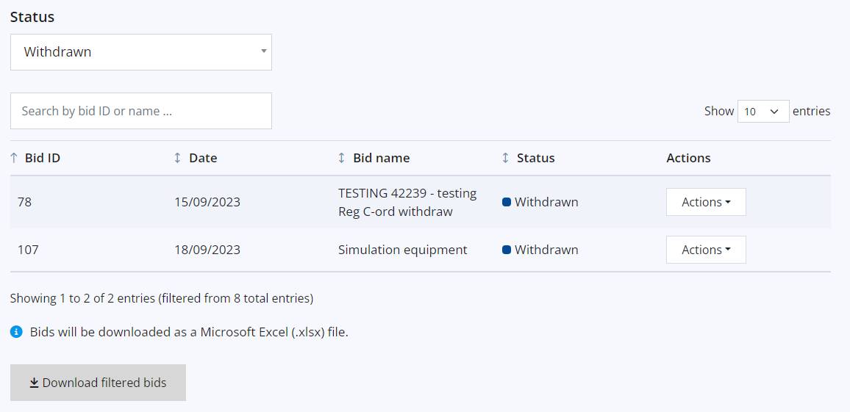
Download Filtered Bids
The status and search options can be used to filter what is shown in the bid summary table. The download option will then only download the bids which are currently appearing in the summary table.
For example, if you choose to show only withdrawn bids (via the Status dropdown), selecting to download filtered bids will only download those with the Withdrawn status.
Contents Page

Slide 45
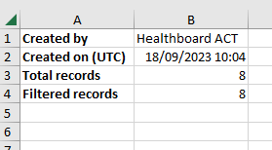
Download Filtered Bids
The downloaded Microsoft.xlsx file has two tabs:
Results – which displays details relating to each bid
Info – which displays details about who downloaded the bid, when they downloaded it, the total number of records for the Health Board, and the number of filtered records included in the download.
Example of Info tab view:
Contents Page

Slide 46
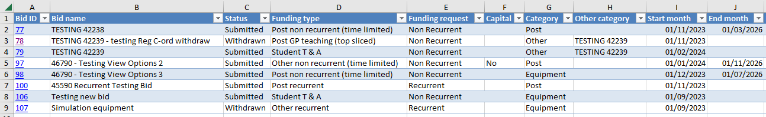
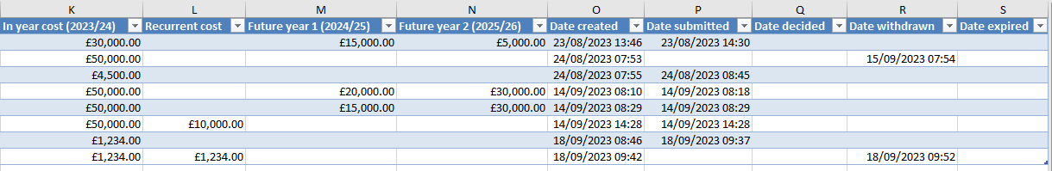
Download Filtered Bids
Example of Results tab view.
For the Bid ID column, each bid is hyperlinked. Clicking on the Bid ID will take the user to the View page of the specific bid so the user can see it in more detail. If the spreadsheet is shared with others they will need to be a Medical ACT AP user to view the hyperlinked information.
Contents Page

Slide 47
Download Individual Bids
Applicable roles:
All
Contents Page

Slide 48
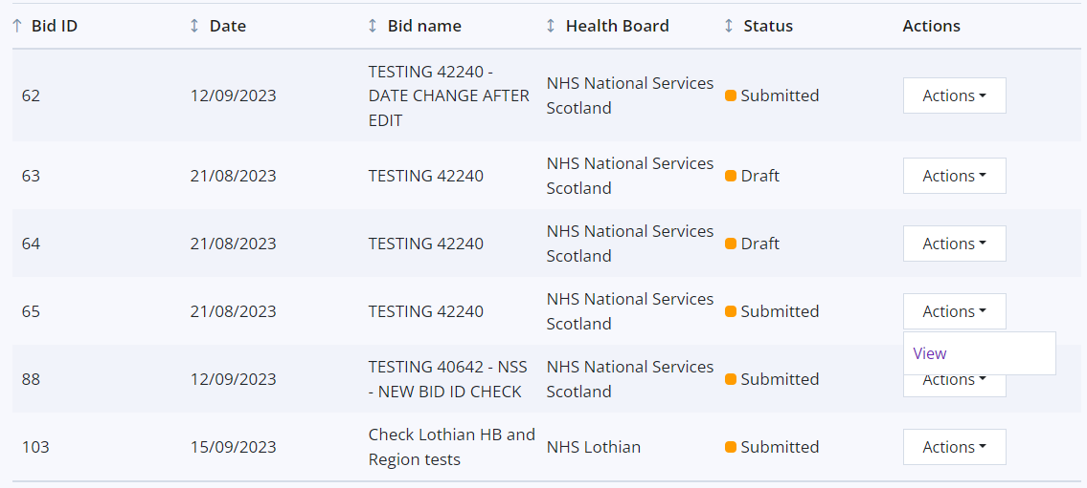
Download Individual Bids
Users can save individual bids as a PDF by using the View option from the Actions dropdown of the bid summary table:
Contents Page

Slide 49
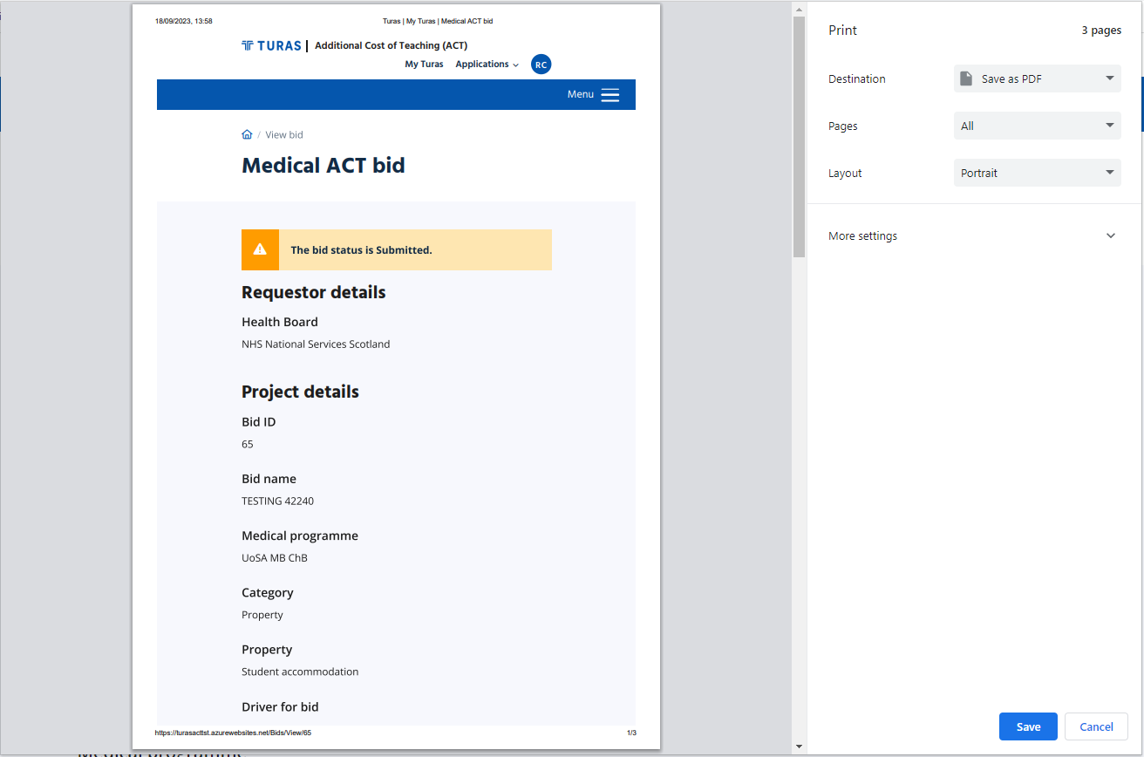
Download Individual Bids
This will display all details of the bid which were inputted when it was created. The user can then use CTRL+P and save the page as a PDF.
Contents Page

Slide 50
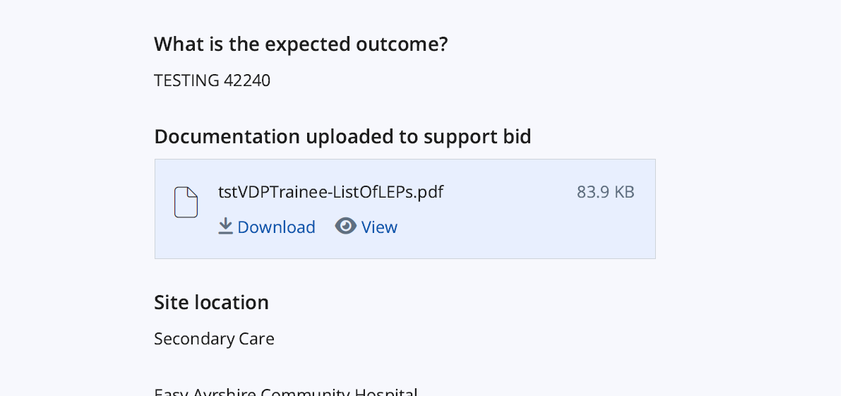
Download Individual Bids
If additional documentation was uploaded when the bid was submitted, the PDF will contain the link to this. The user can then download or view the file on their browser. Only those with access to ACT will be able to download or view the linked file.
Contents Page

Slide 51
Troubleshooting
If you do not have a Turas account, please register here: https://turasdashboard.nes.nhs.scot/) with your email and a password.
If you are a Health Board user or Regional act Co-ordiantor and cannot see the Medical ACT APP when you log in please contact us.
If you are a RAWG member view access is not part of the initial release and we will advise more information shortly.
We value your feedback on the functionality of the Medical ACT APP.
Please get in touch via email to nes.medicalact@nhs.scot
Contents Page

