Slide 1
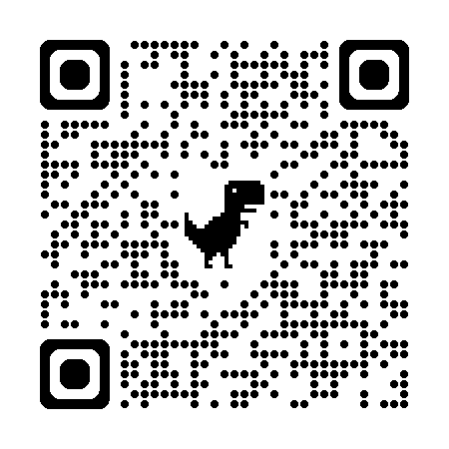


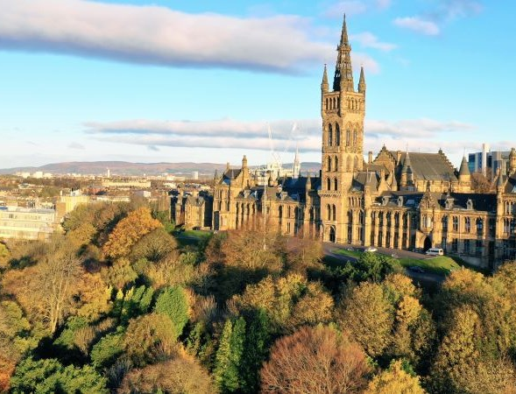
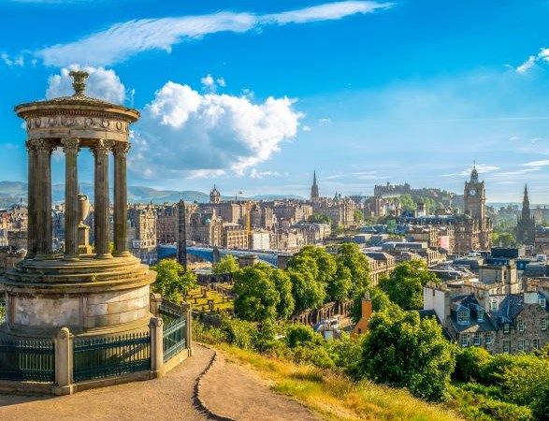
National GPST courses in Scotland Aug 24-Aug 25
(further dates to be released and advertised when confirmed)
TURAS booking link: https://learn.nes.nhs.scot/64065/gp-teaching-courses/national-gp-training
COURSE | Timing | DATE 1 | DATE 2 | DATE 3
The Knowledge Network: accessing and appraising evidence for use in clinical practice | 9am – 1pm | Tuesday 18th March 2025 | Thursday 26th June 2025 | TBC
Armed forces and the veteran community: an introduction to management in primary care | 9.30am – 12.30pm | Tuesday 11th March 2025 | TBC | TBC
Sustainability GPST virtual update | Variable – see as per date | Tuesday 25th February 2025, 2 to 4pm | Tuesday 13th May 2025, 10am to 12pm | TBC
Prostate Cancer UK webinar - *booking details circulated separately | 1-2pm | Tuesday 1st April 1pm to 2pm on Teams | TBC | TBC
Paediatrics – Common musculoskeletal (MSK) and orthopaedics presentations in Children and Young People (CYP), including normal variants | 9am – 12.30pn |  | TBC | TBC
Gambling harms and the support available | 12.30-2pm |  |  | TBC
ST1 QIP support courses (2 workshops, 4 cohort options) - *booking links on flyer | SEE SEPARATE FLYER | ALL COHORT DATES AS PER SEPARATE FLYER
ST3 QI and leadership - *booking details circulated by QI team | 9.30am – 1pm or 2-5.30pm | ALL COHORT DATES AS PER SEPARATE FLYER |  | TBC
Scottish Cancer Referral Guidelines – dates to be released after Feb 25. The following online resource is available: Gateway C - Home - GatewayC
Notes:
Next couple of slides cover other teaching opportunities.
Now a number of course moved to a national approach rather than being run regionally for August 2024 – separate slide coming re Bitesize

