Slide 1
10th Annual Medical Directorate Awards
Professor Emma Watson, Executive Medical Director
Notes:
Welcome to the 10th medical directorate awards.
My name is Emma Watson and I am the Executive Medical Director of NHS Education for Scotland.
The past year has seen continued pressure on every part of the NHS in Scotland.
Despite the service pressures, individuals and teams have worked above and beyond to keep the wheels of medical education turning.
Today, I am delighted to acknowledge and honour some of those who have played their part,.

Slide 2
Award Highlights….
Nominations from across Scotland
Panel: Medical Schools, Directors of Medical Education, Foundation, General Practice, Trainees, Postgraduate Deans
All nominees will receive formal acknowledgement
Notes:
This year, we had a large number of nominations for the NES awards from across Scotland. I am grateful to those who submitted nominations, and also to the Awards Panel.
I also want to thank the contribution that all those nominated make to education and training.

Slide 3
2023 Awards…
Collaborative Education
Equity, Diversity and Inclusion
Innovation in Training
Scholarship and Research in Medical Education
Staff Support
Outstanding Role Model
Notes:
Today I will be announcing runners up and winners for six awards.
Those who were nominated but are not announced today will separately receive an acknowledgement from NES.

Slide 4
g
Award for Collaborative Education
Notes:
The first Award is for Collaborative Education.
This award is given in recognition of an individual or team who has developed an education package that includes learners from medicine and at least one other health or social care profession.

Slide 5
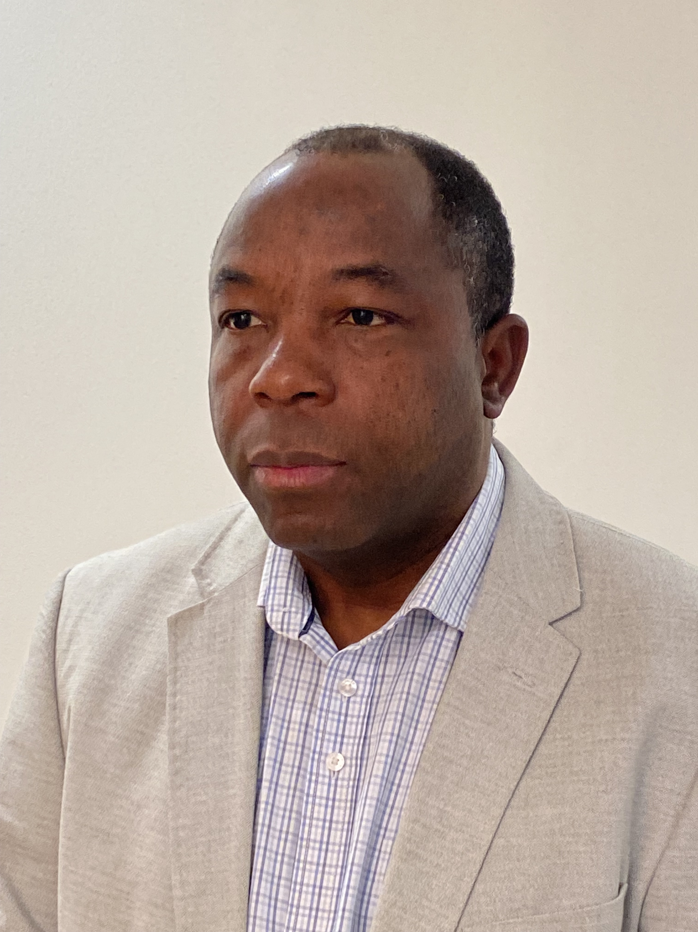
Runner Up
Ishaku Bitrus
Notes:
The Runner up is Ishaku Bitrus
Rev Bitrus is a Healthcare Chaplain, who has been running a support programme for foundation doctors in Greater Glasgow and Clyde since 2017, in conjunction with the Foundation team. Ishaku is passionate and deeply motivated in this work, recognising the need for our most junior colleagues to receive pastoral support
The 2022 award for Collaborative Education goes to….

Slide 6
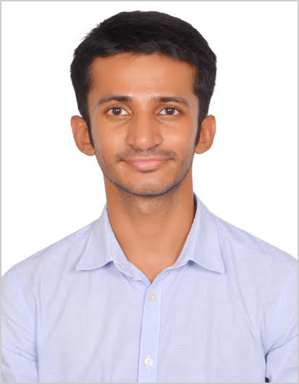
Winner – Collaborative Education
Dr Praveen Kumar
Notes:
Dr Praveen Kumar, a Core Trainee in Psychiatry, NHS Highland.
Dr Praveen Kumar was instrumental in setting delivering Psychological First Aid training for school based teachers and guidance staff to helpful them support Ukrainian children who had been placed in their schools, through the Scottish refugee placement programme. Praveen tailored the programme, led all the training and recruited support from colleagues to help.
The evaluation showed enormous appreciation for the training. Praveen pitched the material at the right level without overwhelming staff and the sessions were reported to be very engaging, and professional. Praveen also led a post-training assessment which showed benefits to these profoundly vulnerable child and adolescent refugees.
Congratulations!
The next award….

Slide 7
g
Award for Equity, Diversity and Inclusion
Notes:
…..is for Equity, Diversity and Inclusion.
This award is given in recognition of achievement and commitment to supporting diverse and inclusive practices in medical education.
The winner is

Slide 8
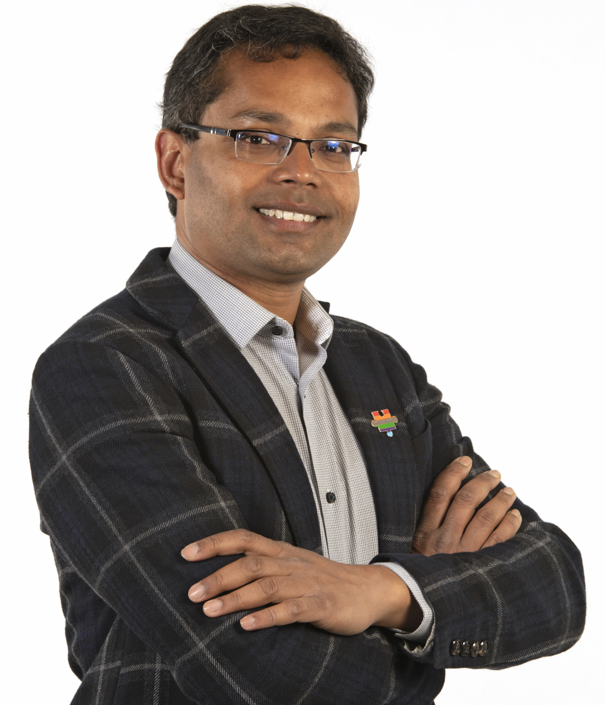
Winner – Equity, Diversity and Inclusion
Dr Snehashish Banik
Notes:
Dr Snehashish Banik
As lead on a portfolio of EDI initiatives across NHS Grampian, Aberdeen University & North region, Sneh conducted a survey of Foundation Doctors that revealed experiences of racism and concerns about speaking out due to fear of reprisals.
In response, Sneh has worked tirelessly and collaboratively with the executive team in NHS Grampian and Aberdeen Medical School with an aim of eradicating racism from the NHS & beyond.
Sneh has led, empowered and supported a very wide range of changes in Grampian, from clinical departments to NHS Grampian Board. He has co-authored the NHSG EDI & Human Rights Policy & helped develop a rapid reporting system for victims of discrimination. His article entitled ‘It’s OK to talk about race’ is published in the NES newsletter in April.
Dr Banik also actively supports medical students & trainees with protected characteristics through a number of initiatives. He is a confidential contact for medical/dental students & trainees who are willing to speak in confidence about discrimination. He is a regular speaker at the Professional Practice Block for Undergraduates, and is acknowledged as the driving force behind the NHS Grampian pledge to embed principles of anti-discrimination at the heart of their strategic & operational processes.
Congratulations!
The next award is for Innovation in Training

Slide 9
g
Award for Innovation in Training
Notes:
This award is given in recognition of education or training that goes beyond the expected level of curriculum delivery.
The runner up is….

Slide 10
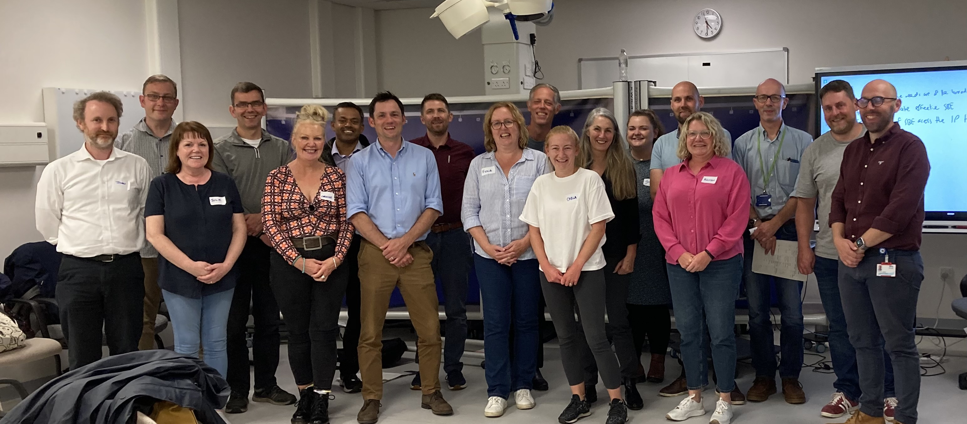
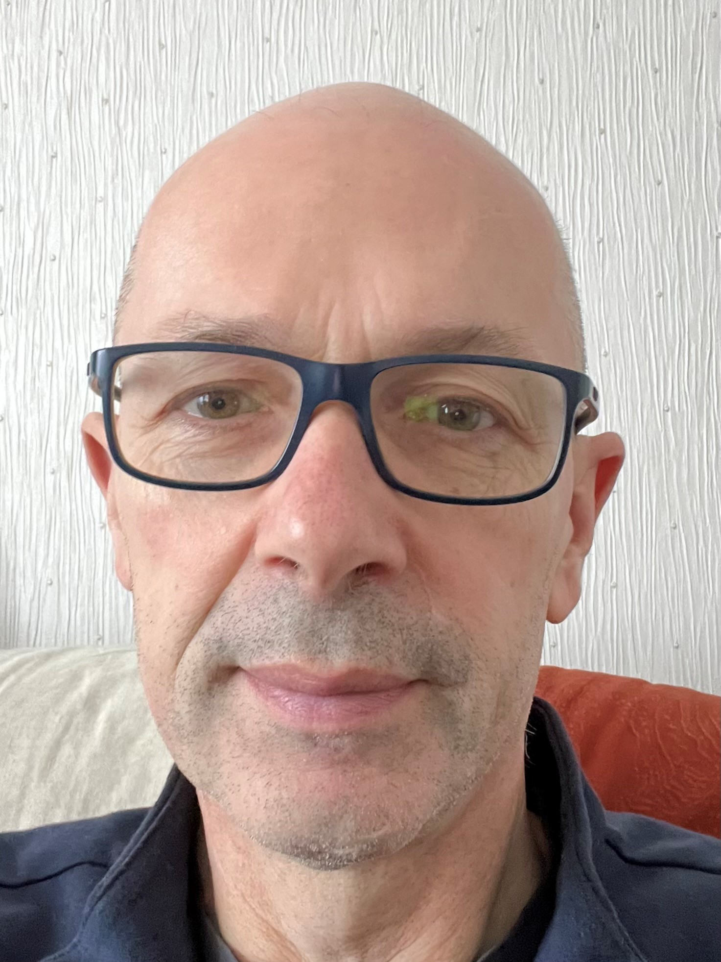
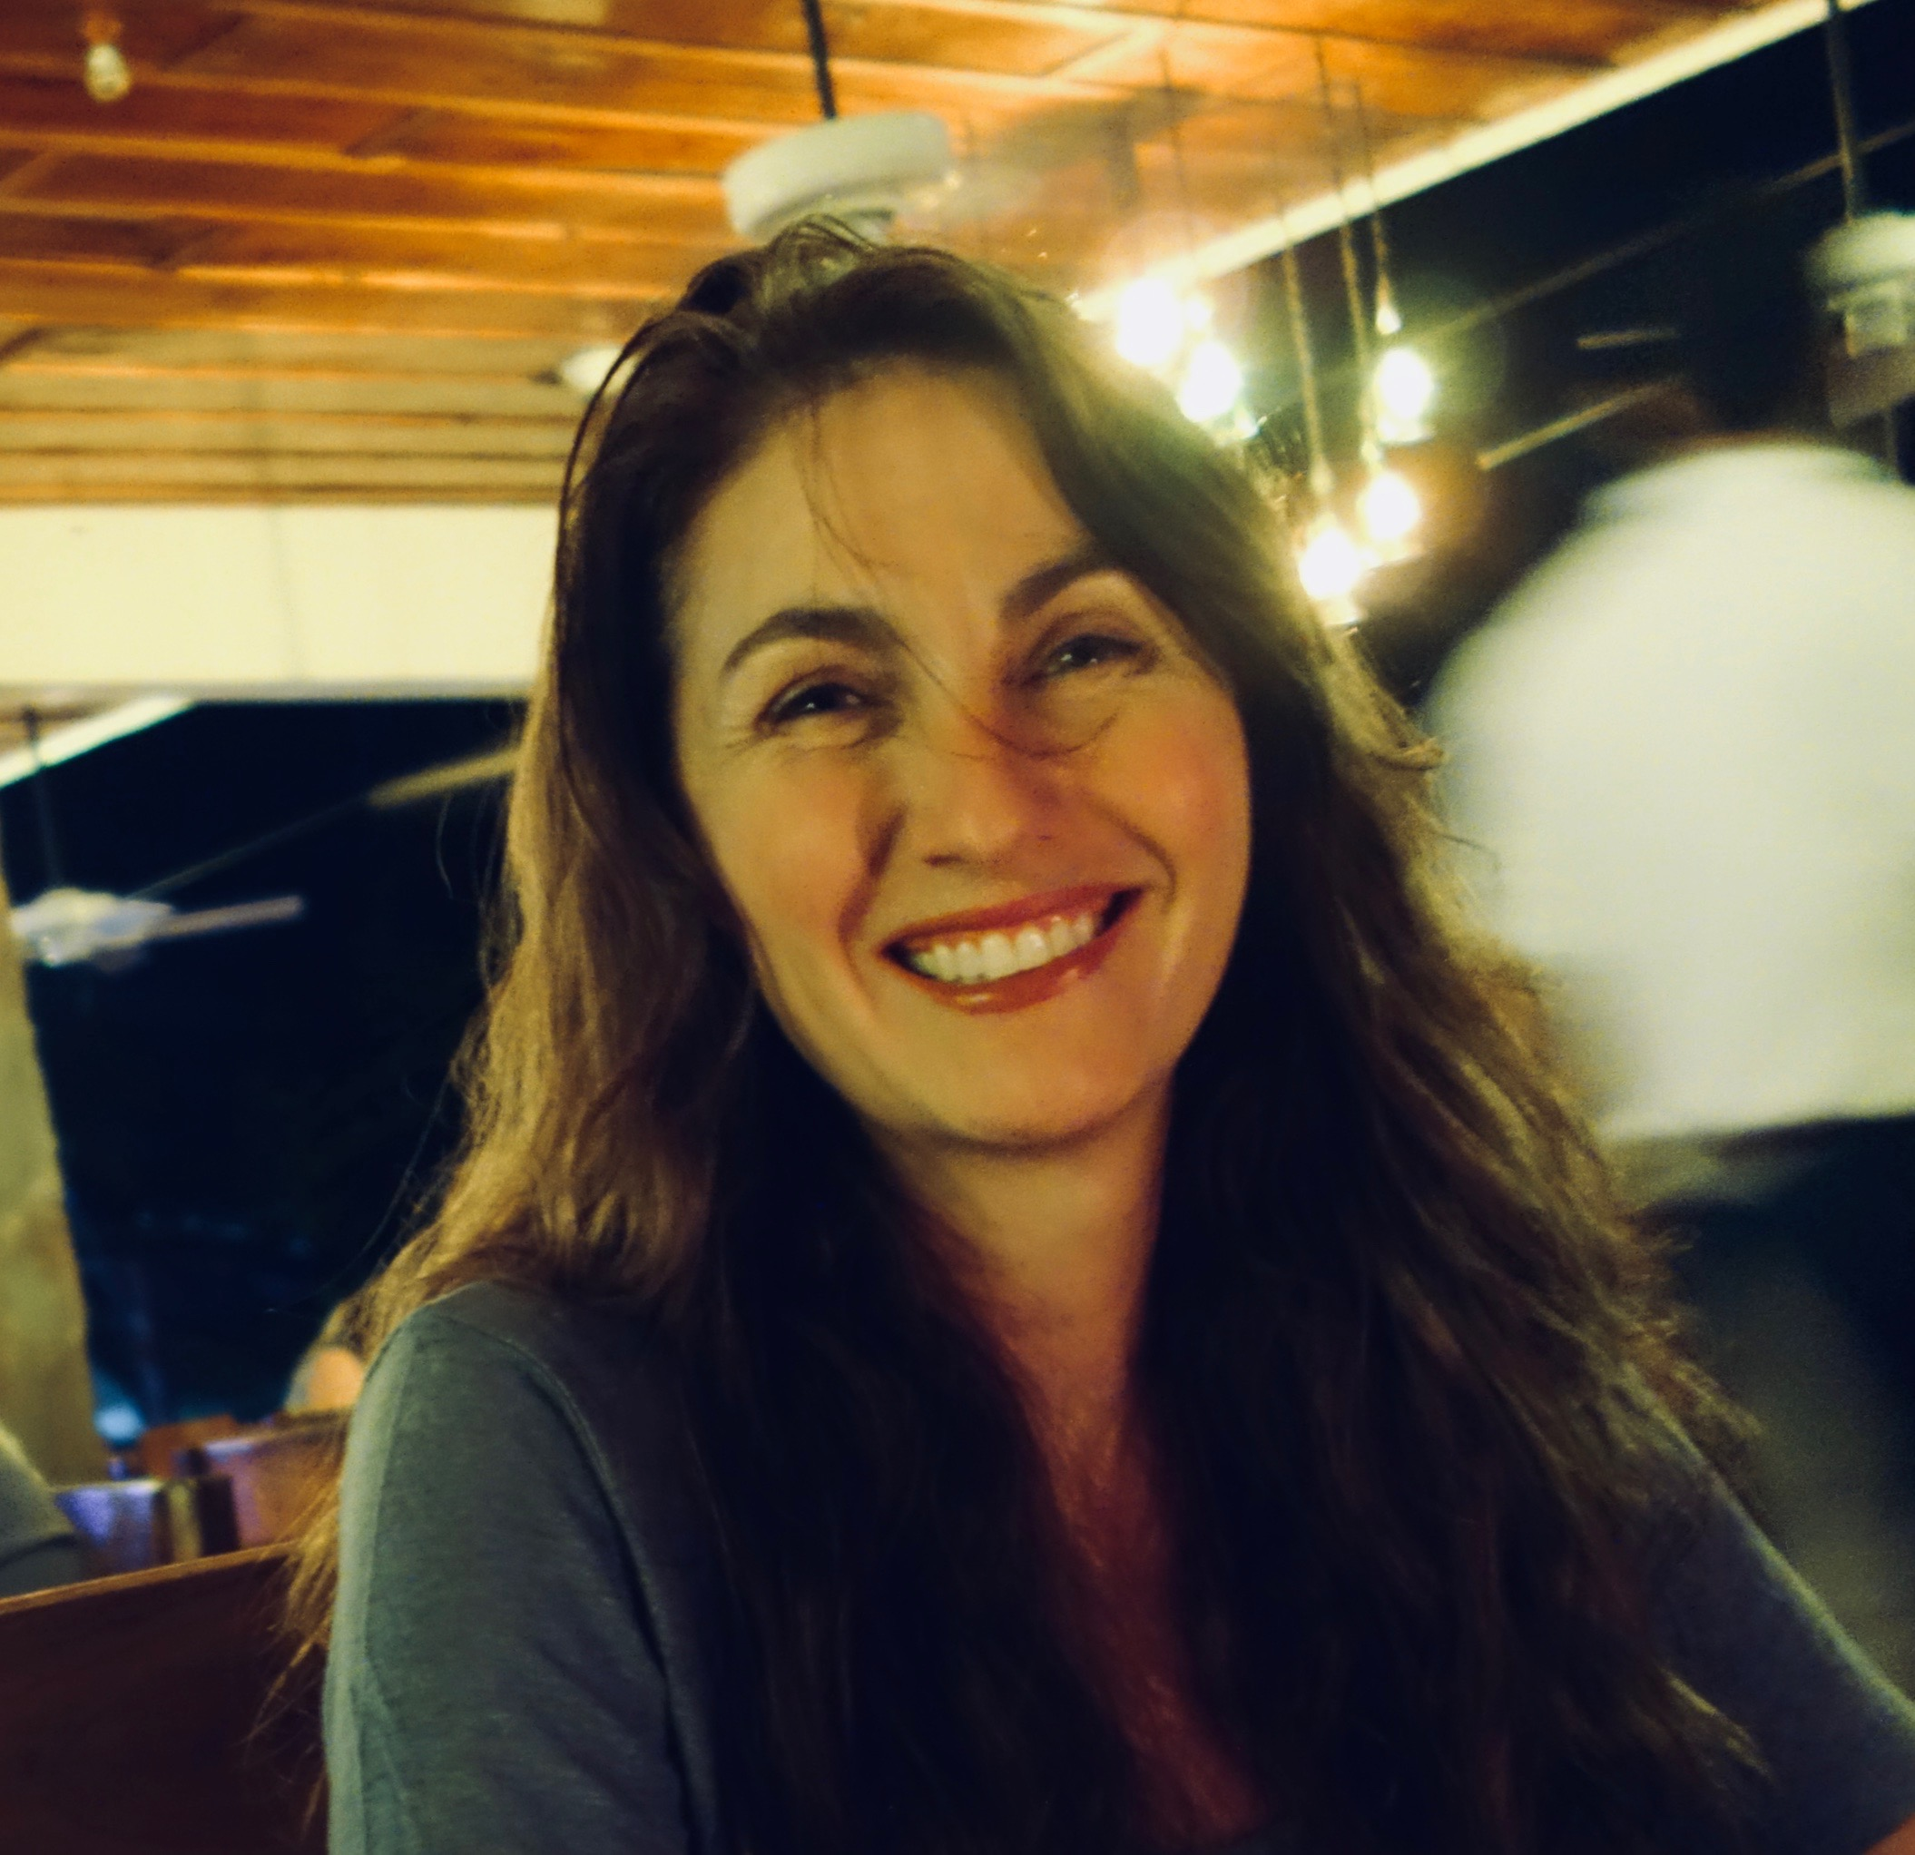
Runner Up
Michelle Thornton
Aidan Cahill
Catherine (Karen) Boylan
Notes:
Miss Michelle Thornton, Dr Aidan Cahill, Mrs Catherine (Karen) Boylan
They are the clinical and programme leads of the National Endoscopy training programme, based at the NHS Scotland Academy. Through their leadership, they have, at great pace, implemented a range of multiprofessional educational programmes for endoscopy teams across scotland. They have done so with an inclusive, collaborative and and national approach.
And the Winner for Innovation in Training is…..

Slide 11
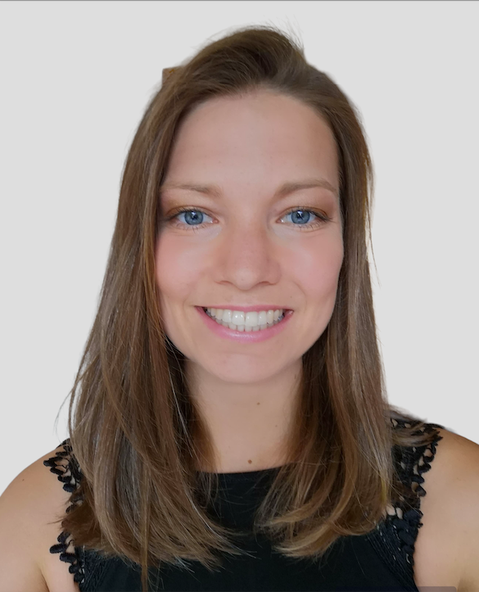
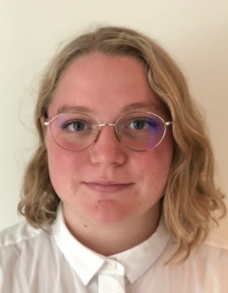
Joint Winners – Innovation in Training
Drs Lesley Arends and Isa Ouwehand
Notes:
Dr Lesley Arends and Dr Isa Ouwehand
As a Foundation Year 2 doctors in the West of Scotland, they set up a teaching series called the Glasgow Series. This was a series of 20 podcasts featuring inspirational Consultants and General Practitioners nominated by FY 2 doctors. Each podcast includes a description of the interviewee’s training and career path, presentation of a memorable case with learning points and discussion about what a career in their specialty would involve. It was done as a response to the training challenges facing everyone during Covid 19. Lesley and Isa arranged the whole project themselves, including recording, editing and publicity. Lesley and Isa have now gifted the series to NES – it is planned to host the series through the Scotland Deanery website and continue to highlight to all FY 1 and FY 2 trainees. Informal and formal feedback of this learner-driven teaching resource has been excellent.
Congratulations!
The next award is new for 2023 and is for

Slide 12
g
Award for Environmental Sustainability
Notes:
…to recognise an individual or team who have made a positive contribution to acknowledging and addressing the impact of climate change through significant initiatives in medical education.
The runner up is….

Slide 13
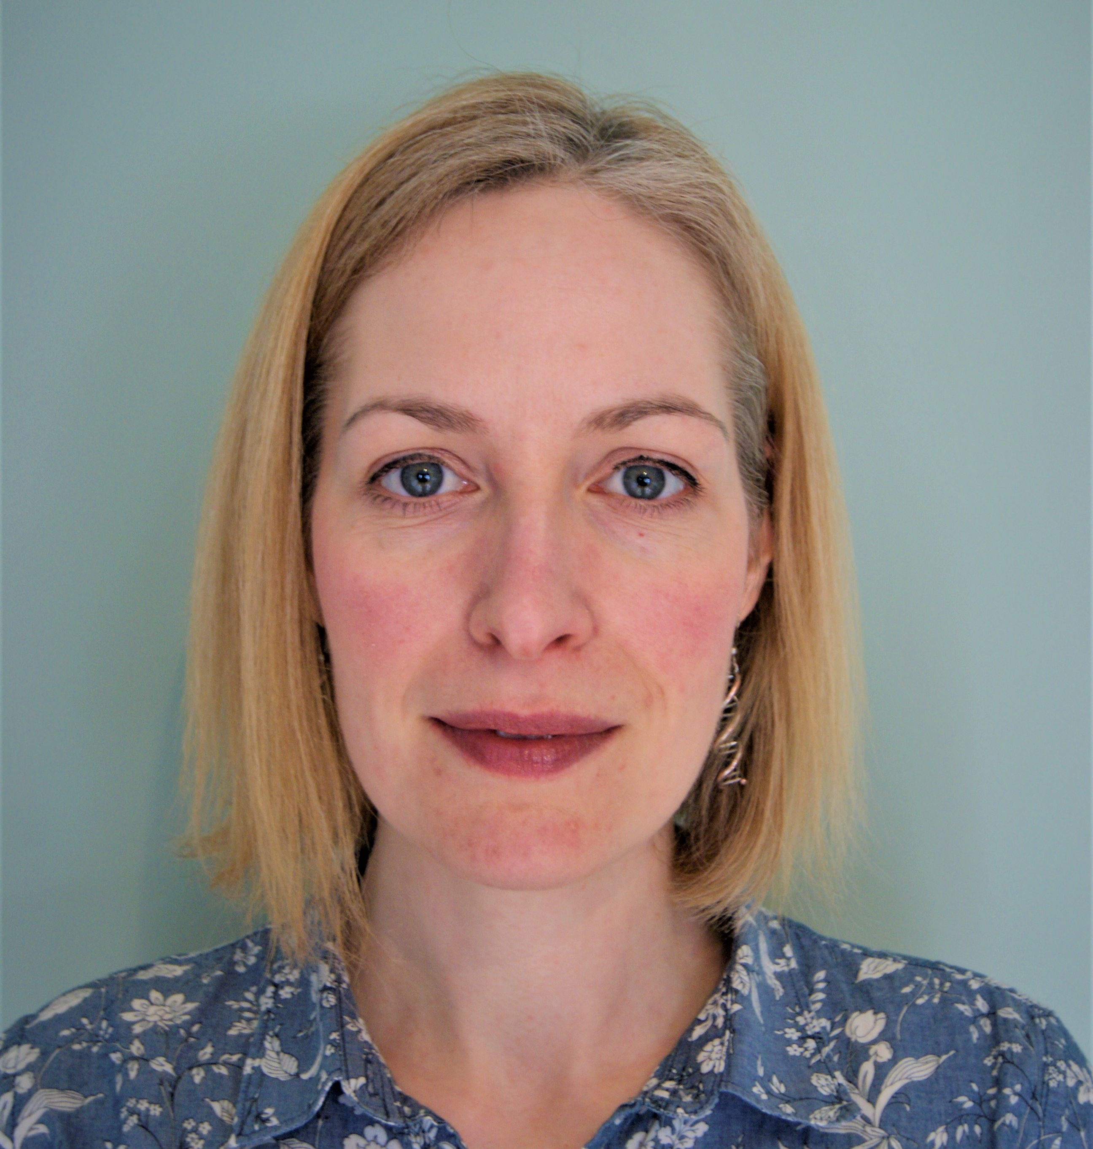
Runner Up
Eleanor Murray and the
Renal sustainability team
Notes:
Eleanor Murray and the renal sustainability team
This team, based in Glasgow, have made huge strides into improving sustainability of renal dialysis in particular within QEUH renal service, bringing about major system and service changes. They are an inspiring and collaborative team who have also presented their work at national conferences.
And the Winner for Environmental Sustainability is…..

Slide 14
Winner – Environmental Sustainability
NHS Highland Medical Education
Team
Dr Rory Gibson, Dr Adelaide Fisher, Dr Siddharth Basetti
Notes:
Dr Rory Gibson, Dr Adelaide Fisher, Dr Siddharth Basett in NHS Highland.
This team developed and delivered an innovative weeklong programme of Climate Awareness education for all NHS Highland staff coinciding with the Scottish Governments National Climate Week 2022. The aim was to address the Climate emergency through medical education. They sourced funding, liaised with third sector organisations, and delivered a considered, wide ranging and thought-provoking programme.
Their programme introduced staff and students to local initiatives to reduce waste, save energy, to develop active travel habits and support, and to aid incorporation of Sustainability into the curriculum. They collaborated with colleagues in NHS Grampian and coordinated talks and teaching sessions to be delivered across the north of Scotland. Yoga lessons, walks and garden visits were mixed with inhaler discussions, the National Green Theatre project talks and students discussing their involvement in the Planetary Health Report card. It was accessible, inclusive, and highly educational week.
The event enthused junior and senior doctors and medical students to form groups and develop projects addressing different aspects of climate change on the Inverness Raigmore site. Sustainability is now embedded into Quality improvement teaching and training in NHS Highland and many further resources have been developed.
Congratulations!
The next award is for...

Slide 15
g
Award for Staff Support
Notes:
Staff support
This award is given to recognise the exceptional support given by education administrative staff across medical schools and health boards.
The runner up is….

Slide 16
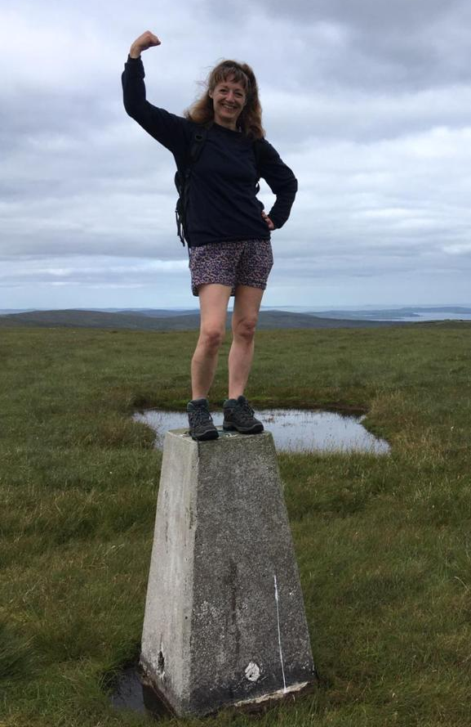
Runner Up
Wendy Cooper
Notes:
Wendy Cooper
Wendy Cooper is the Medical Education Administrator at the Gilbert Bain Hospital, Lerwick, Shetland. As such, Wendy is one of the first people that new medical students and junior doctors meet on their arrival at the hospital. As a pastoral and administrative bridge between them and the clinical teams, Wendy quickly and efficiently makes them feel at home and a part of the close-knit hospital and island community.
If there is anything Wendy can do to help, she does it. Examples include providing home bakes to enjoy after teaching, fetching some shopping for someone who is unwell. Her dedication to her job, the willingness to go beyond its requirements, and above all her thoughtfulness and kindness to her colleagues is an inspiration to those around her.
And the Winner of the Staff Support Award is….

Slide 17
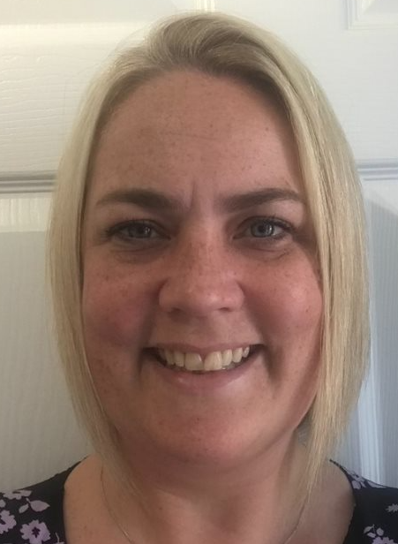
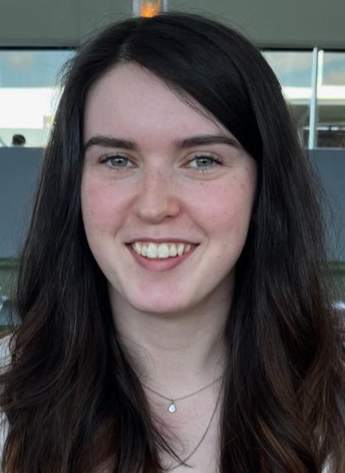
Winner – Staff Support
Ayan Osman, Sam Boyd and Sam Doonan
Notes:
Ayan Osman, Sam Boyd and Sam Doonan, who are the medical rota team at the Queen Elizabeth University Hospital, Glasgow.
They have worked above and beyond to ensure ensuring safe staffing during the COVID pandemic and the current NHS pressures over the last few years. In a very challenging and fast-paced environment, they work tirelessly day-in and day-out to ensure that medical staffing is safe to deal with current pressures. In addition to their day-to-day job, they also organise the departmental induction for all new trainees joining the QEUH campus.
They attend handovers to address any trainee concerns about staffing or unforeseen acute gaps that may impact junior doctors wellbeing and will make plans in place to ensure that cover is sought and provide continency plans. They are actively involved in ensuring that junior doctors have their breaks. They are also very supportive of the Junior Doctors Forum and establish rapport with all trainees by organising rota drop-in sessions for all trainees which happens fortnightly.
They are truly the unsung heroes of the General Internal Medicine Management Department due to the tremendous amount of work they are required to do daily.
Congratulations! Our next category is the Award for Scholarship and Research in Medical Education

Slide 18
g
Award for Scholarship and Research in Medical Education
Notes:
This award is given in recognition of the creation, dissemination, application and translation of medical education knowledge.
And the runner up is….

Slide 19
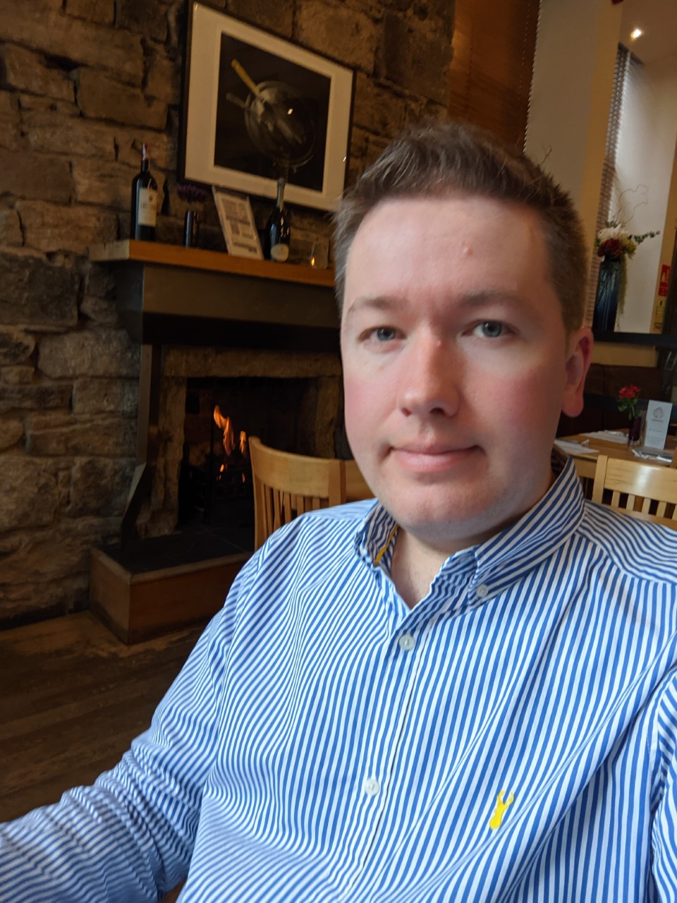
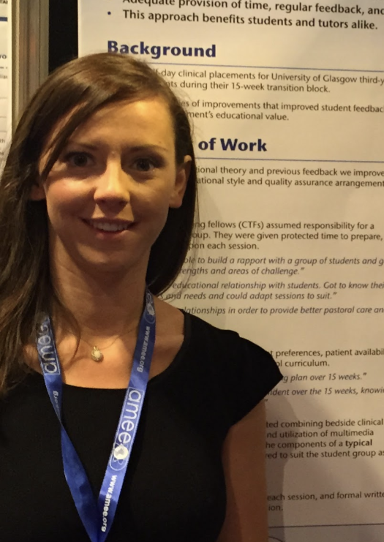
Runner Up
Dr Scott Oliver and Dr Kathleen Collins
Notes:
Dr Scott Oliver is a Consultant Nephrologist and Dr Kathleen Collins a Paediatric Specialty Doctor, both in NHS Lanarkshire.
Both have a passion for professionalism, EDI and civility, and have dedicated work towards an evolving professionalism work stream. They have worked to develop primary research in the area, and developed innovative programs, workshops and other initiatives to translate educational theory into real world practice, Education and learning. They conceived and chaired the highly successful co-chair of the highly successful Professionalism in Healthcare Conference in 2021 and each hold senior roles across undergraduate and postgraduate medical education.
And the winner of the Scholarship and Research Award is...

Slide 20
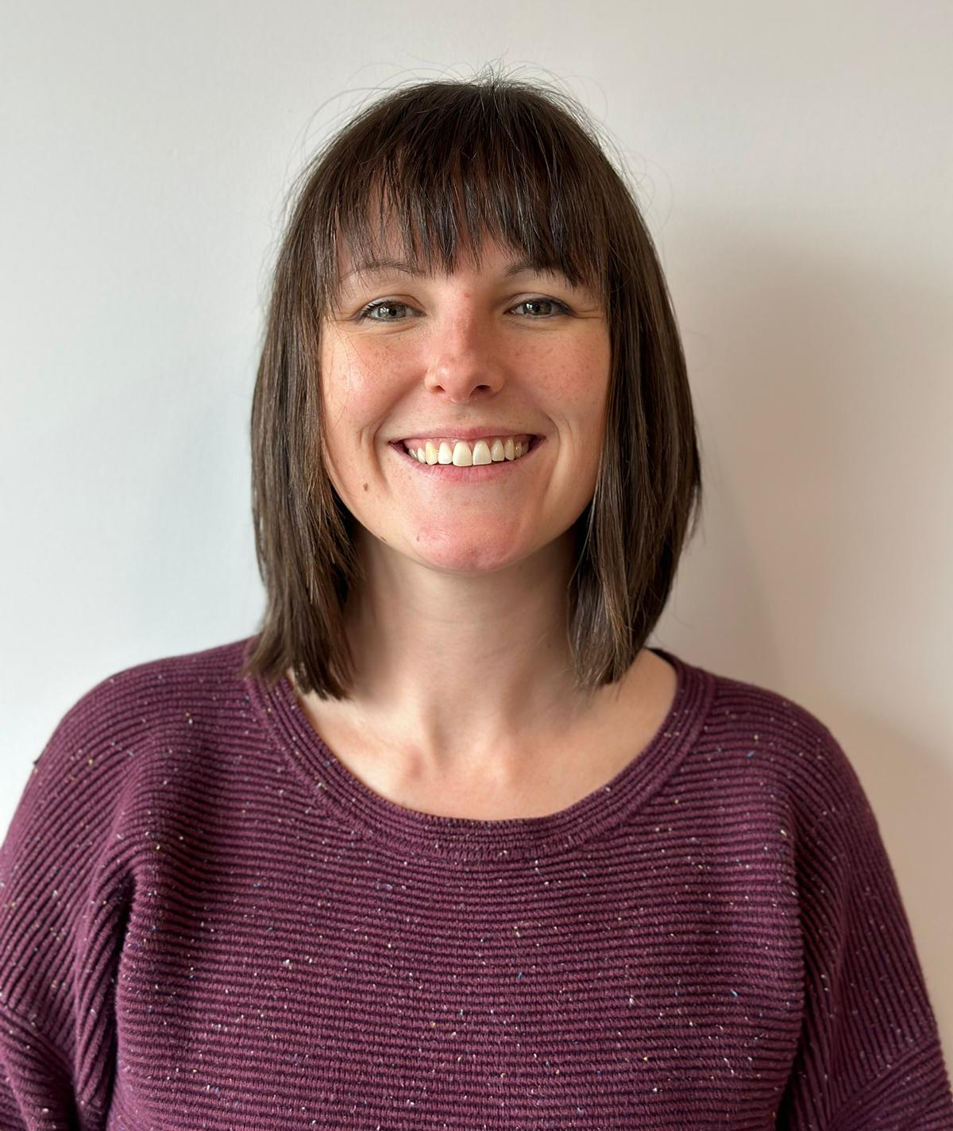
Winner – Scholarship and Research in Medical Education
Dr Joanne Kerins
Notes:
Dr Joanne Kerins, Acute Medicine trainee, West of Scotland and part time IMT Simulation Research Fellow, Scottish Centre for Simulation and Clinical Human Factors
Dr Kerins has developed and led extensive research on the impact of the Internal Medicine Training Simulation. Having entered the field as a research novice, she has produced research that is having a major impact on both the simulation and wider medical education communities. Since 2020, she has published eight manuscripts as first author, and co-authored an additional seven papers. Joanne's work has been published in the most esteemed medical education journals. Her publication output exceeds the expectations of a full-time researcher and is particularly impressive given the intensity of her clinical work over the corresponding pandemic period.
In addition to establishing international research collaborations, Joanne has co-led a collaboration between the Scottish Centre for Simulation and NHS Lothian to develop and deliver the monnthly Scottish Simulation Journal Club. These monthly online meetings have brought together a community of practice extending beyond Scotland, to include participants from other areas of the UK, as well as internationally.
Congratulations. Our final award is for an outstanding role model

Slide 21
g
Award for Outstanding Role Model
Notes:
This award recognises an individual whose behaviours, examples or successes have inspired medical students or postgraduate trainees in Scotland.
In a category with many nominees, we have two runners up. They are…

Slide 22
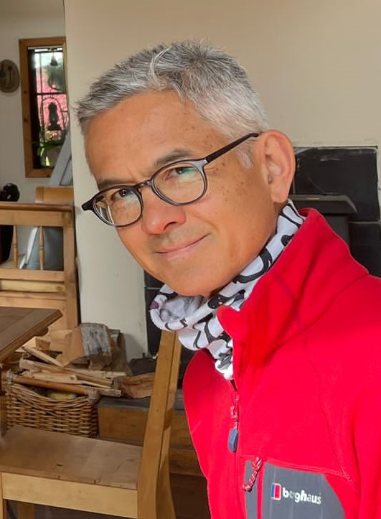
Joint Runner Up
Professor Kim Ah-See
Notes:
First, Professor Ah-See. Kim was nominated by his trainees, who describe him as being totally dedicated to delivering quality teaching for trainees, junior doctors and medical students. He creates a controlled and enjoyable learning environment in even the most challenging operative setting by his ability to stay cool, calm and collected, providing the best possible opportunities to develop skills and confidence.
His practical demonstration of middle ear anatomy using the theatre corridor is remembered fondly by many.
Kim also role models the importance of maintaining a healthy work-life balance and inspires others to do the same.
Our other runner up is…

Slide 23
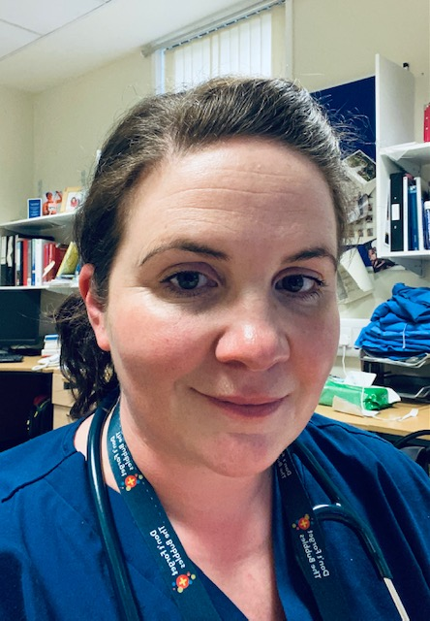
Joint Runner Up
Dr Laura McGregor
Notes:
Dr Laura McGregor, ED consultant, Training Quality Lead at Monklands University Hospital
Following the raising of concerns about behaviours and cultures in a clinical department, Dr McGregor acted immediately and compassionately to investigate the problems within the department. Laura proactively maintained contact with trainees working in difficult situations, and acted as an approachable advocate for individuals as the issues were addressed and the situation improved.
We thank Dr McGregor for her exceptional leadership and dedication to trainee wellbeing, training and patient care.
And the winner of the outstanding role model 2023 is....

Slide 24
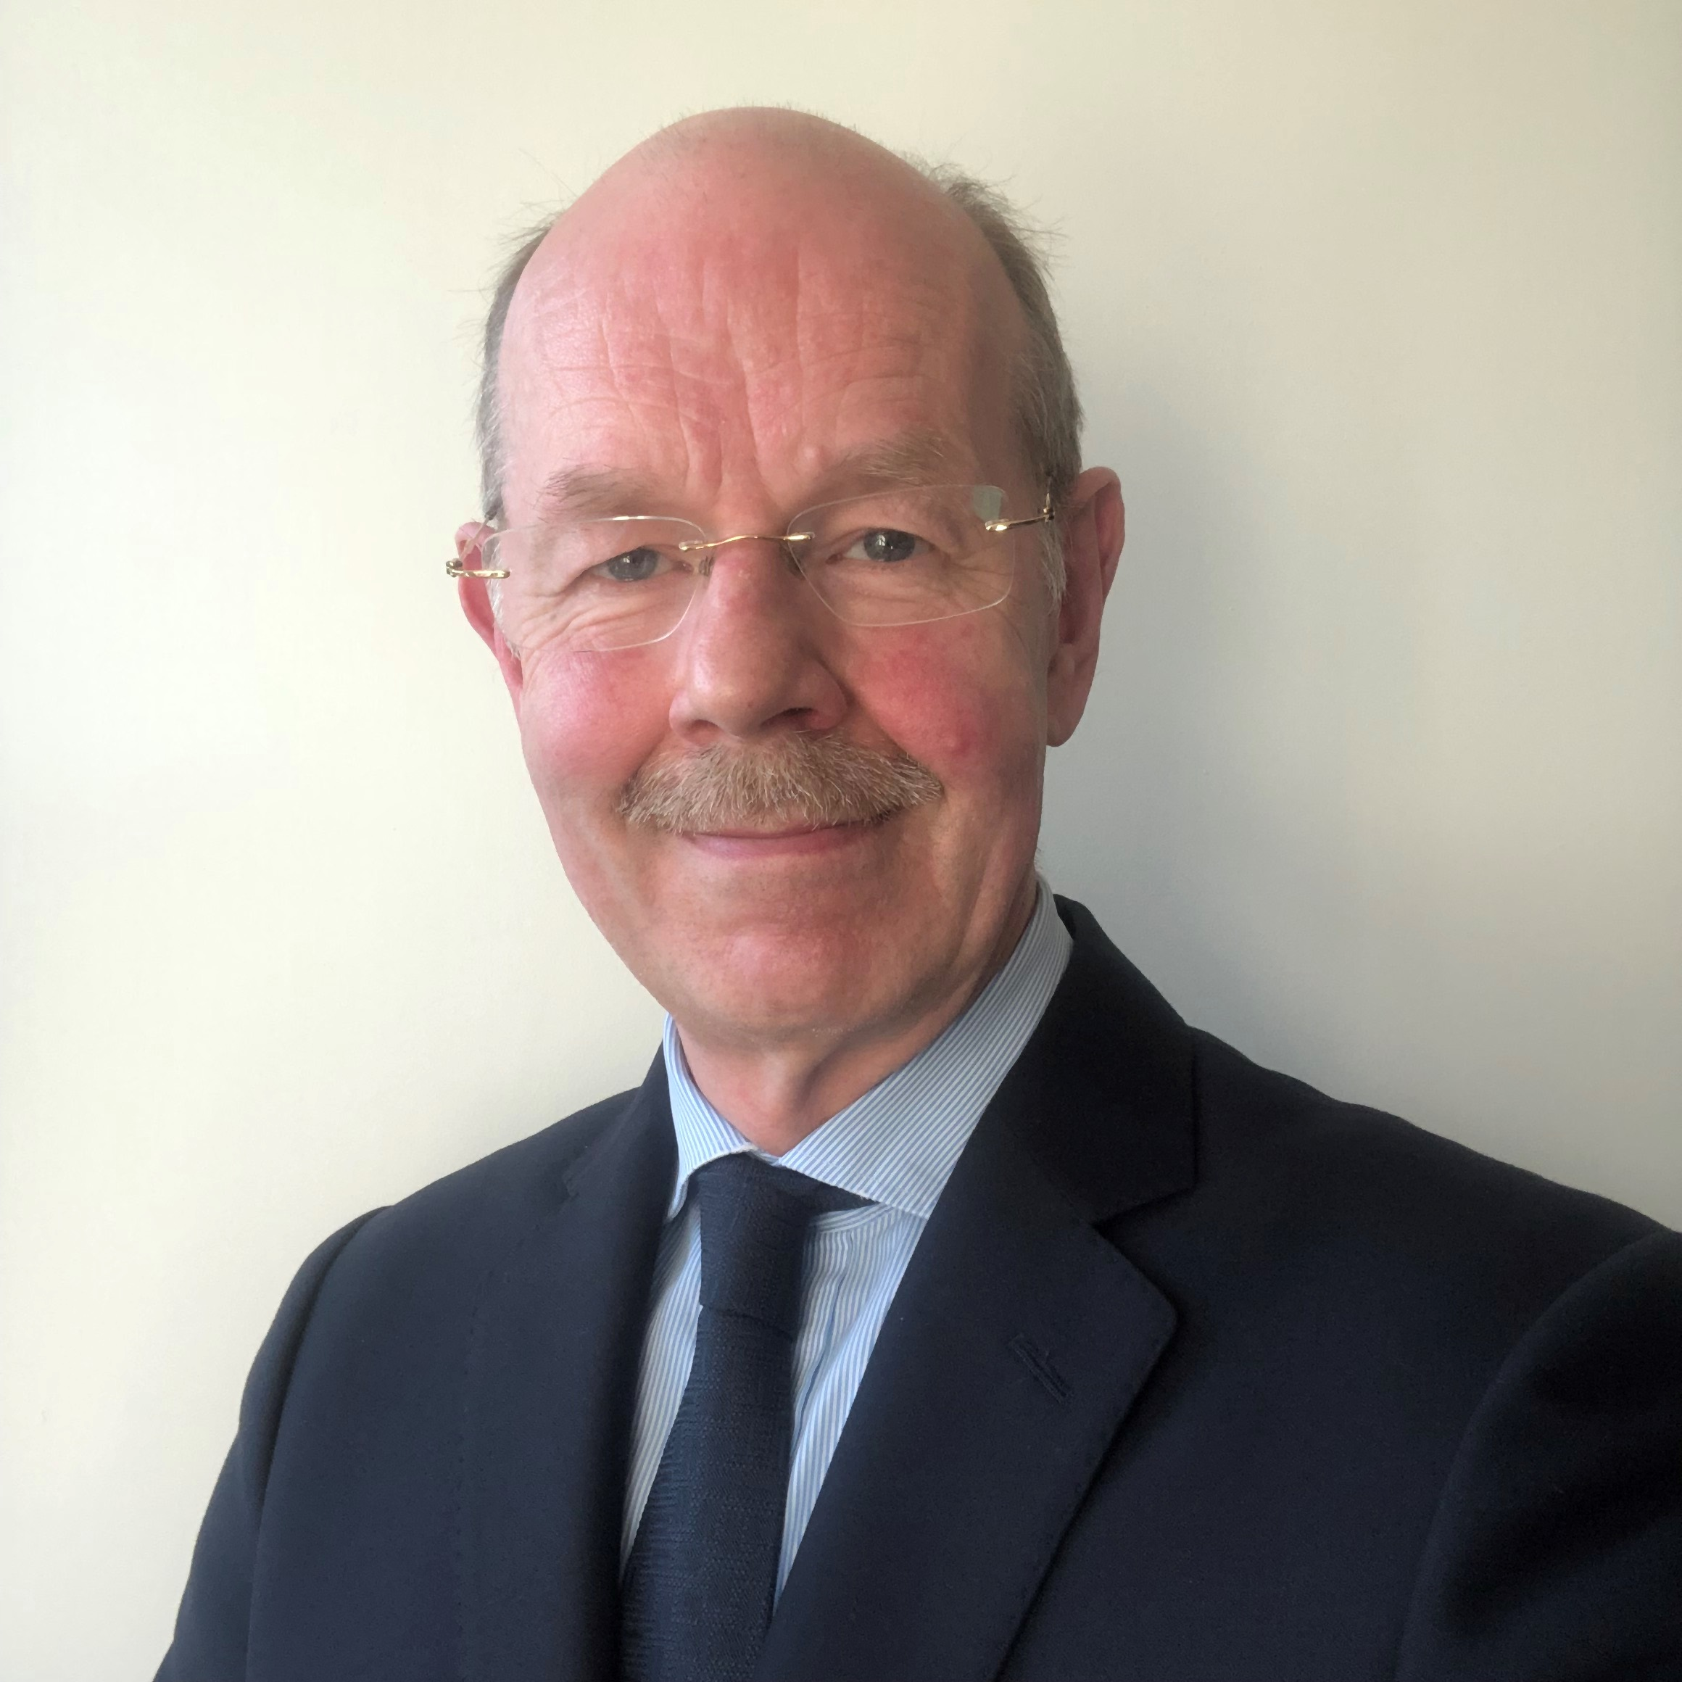
Winner – Outstanding Role Model
Professor Alastair Mclellan
Notes:
Professor Alastair Mclellan
Professor Mclellan has held a large number of leadership roles in clinical practice and in medical education. As the longest serving Postgraduate Dean in Scotland, Alastair has always led from the front and has had a major role in developing the Quality agenda across NES. He has also demonstrated sustained strategic thinking in the planning and then delivery of 30 new postgraduate medical curricula, much of which occurred during the pandemic. Although initially based in the West of Scotland, as Lead Dean, he has developed a very close-knit management team across the four regions.
Scotland is considered an excellent country to train. This is in no short measure down to the attention to detail, leadership and clarity of thought shown by Alastair in his role.
Congratulations, Alastair

Slide 25
10th Annual Medical Directorate Awards
Professor Emma Watson, Executive Medical Director
Notes:
In closing, and on behalf of the Awards Panel, my very warmest congratulations to you all. You are all inspiring, and we thank you for everything you do.

