Slide 1
Knowledge Exchange Workshop
Addressing Staff Wellbeing,
Morale, Recovery and Retention
Notes:
Welcome

Slide 2
Scottish Doctors’ Wellbeing Study
CSO-funded collaboration between all Scottish Medical Schools and NES
Aim: Strengthen understanding around ways that healthcare staff feel Heard, Valued & Supported

Slide 3
Today’s Plan
Small groups: Hear from you
Group discussion: Together discuss issues arising from the small groups
Summarise and agree actions moving forward
Brief Introductions
Overview of Scottish Doctors' Wellbeing Study: What we heard

Slide 4
Who we are
University of Aberdeen – Dr Kim Walker (PI) & Dr Kathrine Gibson Smith
University of Dundee – Dr Lisi Gordon &
Dr Gillian Scanlan
University of Edinburgh – Dr Gill Aitken
University of Glasgow – Prof Lindsey Pope
University of St Andrews – Dr Joanne Cecil, Dr Anita Laidlaw, Dr Tricia Tooman​, Dr Kathryn Cunningham & Mr Patrick Cairns​
NHS Education Scotland – Prof Peter Johnston, Dr Julie Ferguson & Dr Judy Wakeling
Notes:
Invite participants to share a brief introduction
Ask: What are your aims for the day? What would you like to get out of our time?
Conclude: this is a ‘safe space’—agree basis of sharing further (e.g. no individuals identified, any statements provided to all for review/feedback)

Slide 5
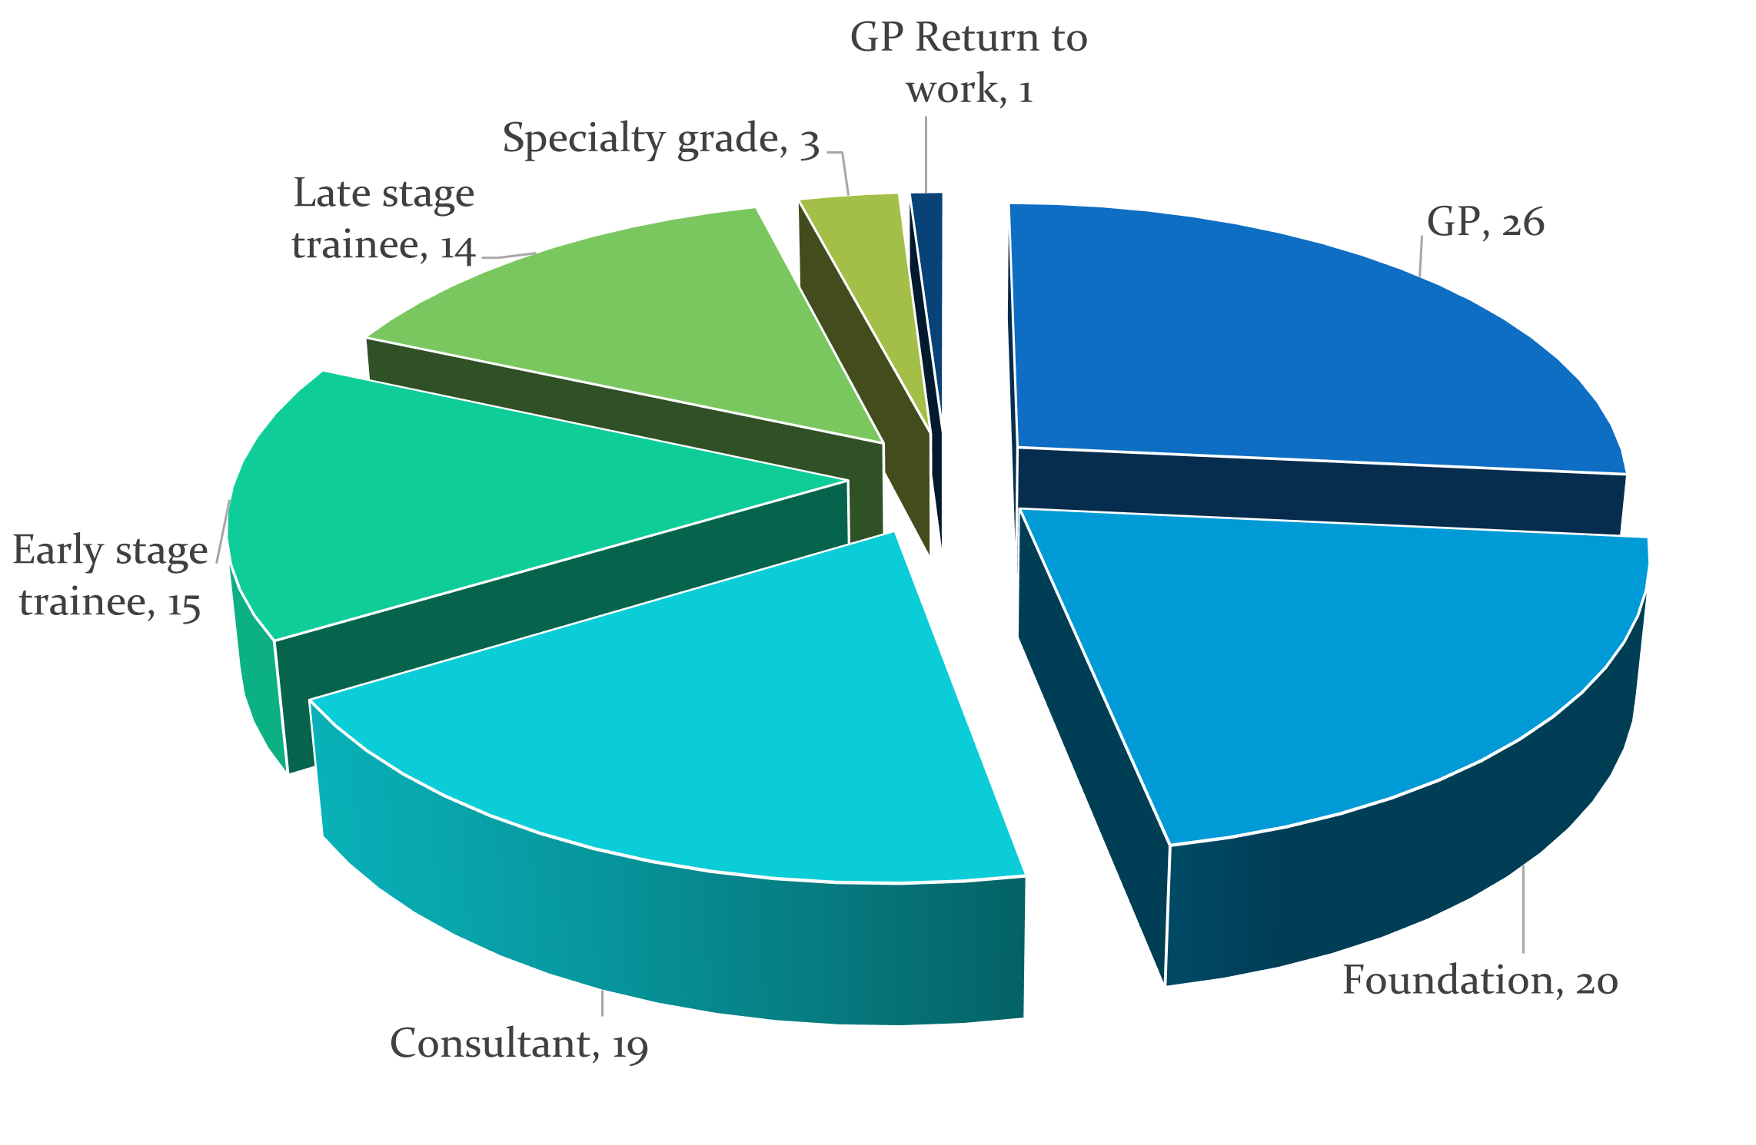
Who we talked to
Notes:
[Add fireworks/bubble-type display of participants –GPs, FYs, etc; age ranges, specialisations?] SDQs—career grades; distribution across Scotland—red dots representing numbers

Slide 6
Who we talked to
Notes:
Distribution across Scotland—red dots representing numbers

Slide 7
What we asked
Experiences in work, home and learning environments
Support mechanisms
Notes:
We asked about their experiences in their work, education and life resulting from Covid. We asked what challenges they faced as well as the kinds of support they experienced. Work/Home/Social image

Slide 8
How much evidence
2,195,570 words
=
Notes:
Interview transcripts: 247
Audio diaries: 300
Email dairies: 26
Total pieces: 573
Total hours, minutes and seconds of data: 281 hours, 29 minutes and 15 seconds (i.e. not far off of 12 solid days of listening to Scottish doctors)
Estimated total words: 2,195,570

Slide 9
What we learned
The pandemic has magnified existing challenges
to healthcare staff’s wellbeing
What they want? To be and feel:
Heard
Valued
Supported
Notes:
We took a complex view of wellbeing that encompassed not just the physical and psychological, but social and cultural support as well.

Slide 10
There’s a lot being said at the moment and sent out in emails about emotional wellbeing and support…it’s very visible that there’s an effort towards looking after mental wellbeing in employees, and it’s a good start. But I think that a lot of people are thinking, 'Well, this is just what’s fashionable to do whilst we’re in this pandemic.’
(GP, Interview 1)​

Slide 11
Ways this evidence can help
Consider meaningful ways to address staff
Wellbeing
Morale
Recovery
(Ultimately) Retention

Slide 12
Notes:
One snapshot from the SDW study. R&R was a tangible example of meaningful organisational support. Practical and symbolic. There is some mismatch between what boards have said and what doctors said they have experienced.

Slide 13
In my hospital job, for example, whenever a room was taken away for whatever reason, because it needed to be repurposed and used for something else, like there was this huge sense of loss, and everyone was like, oh, where are we all going to go and have coffee and have lunch or whatever, and you have to find - there was this real sense of like needing to find somewhere else that we could go and hang out. And so yes, 100 per cent [R&R spaces are] very, very important.
(ST3, Interview 2)

Slide 14
I’d like the government to learn that actually, in the health service, staff need hot food provided 24/7. They need space to rest when they’re resting, they need the facility to do that, and that’s not optional, if for no other reason than, if you provide that for staff, your patient care improves. So, you can sell it on patient care, or you can sell it on a duty of care to your staff, either or.
(Staff Grade, Interview 3)

Slide 15
I wonder whether a lot of the benefits of those spaces is actually more, almost like theoretical, in that it makes people feel valued, the fact that there is a space for them.
(GP, Interview 2)

