Slide 1
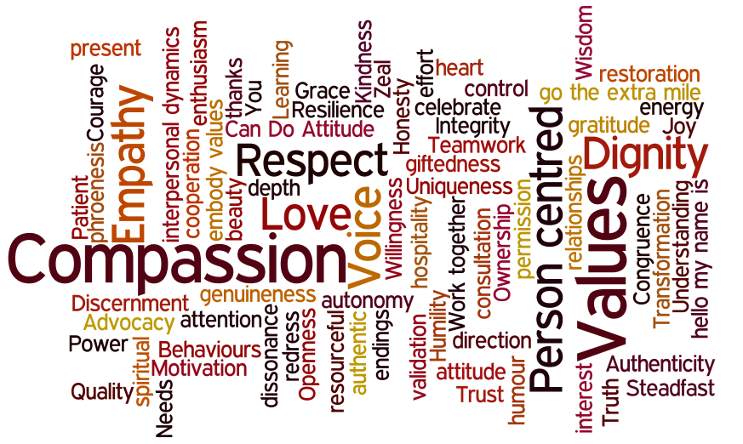
Wellbeing & Resilience
Paul Graham
January 2021

Slide 2
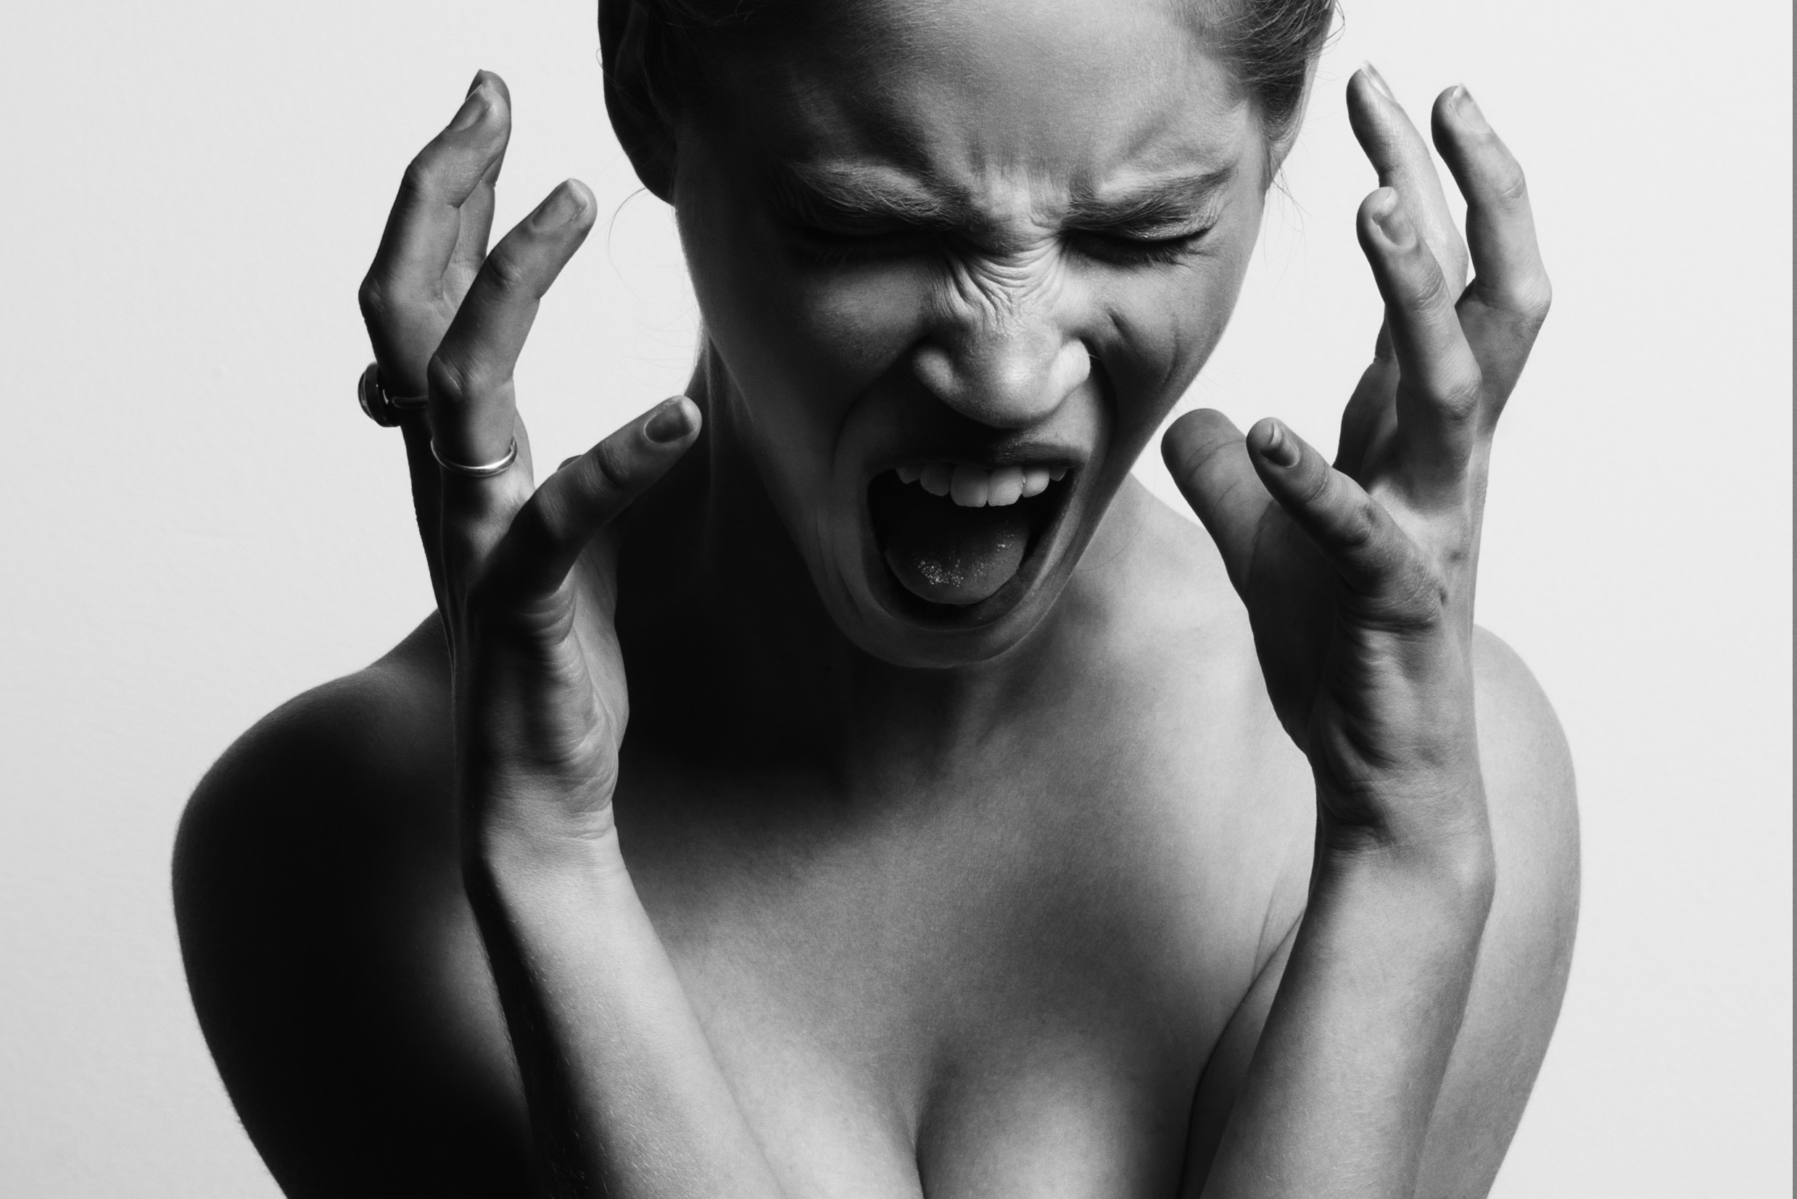

Slide 3
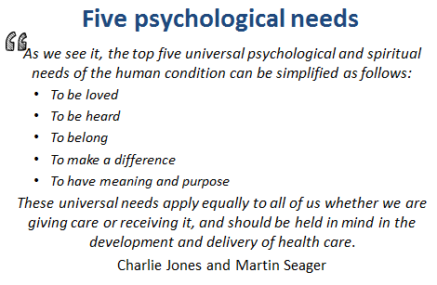

Slide 4
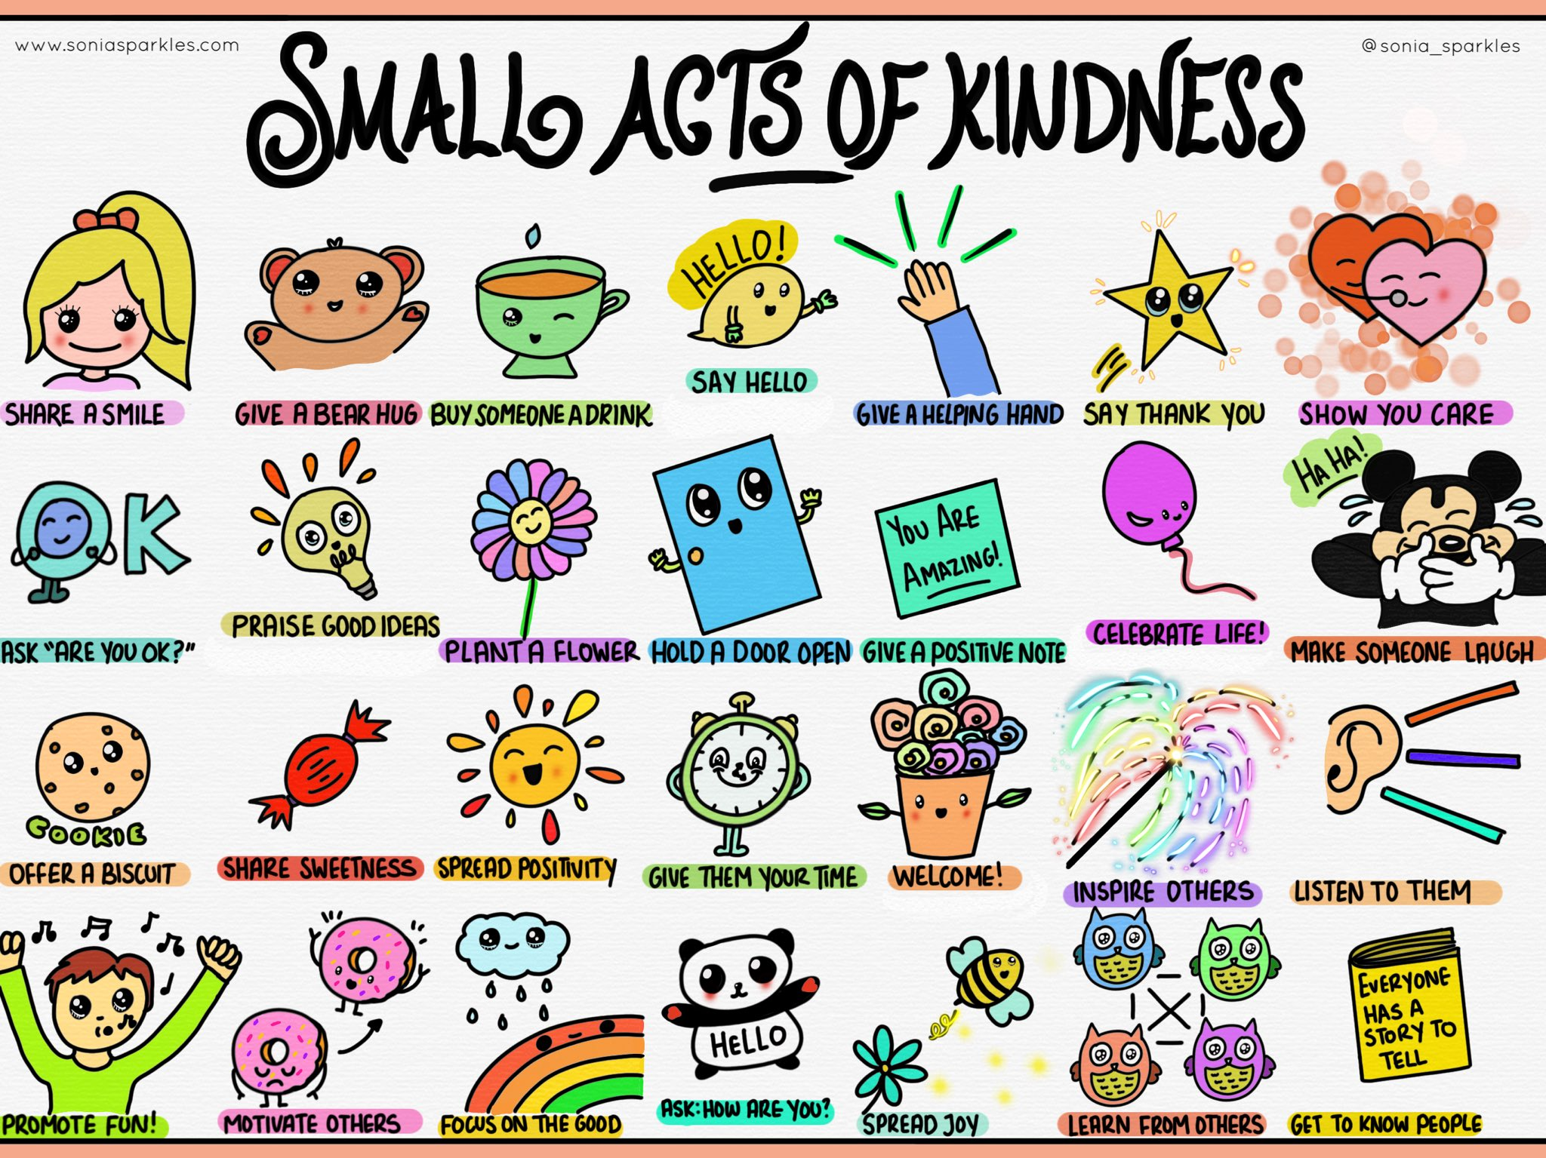

Slide 5
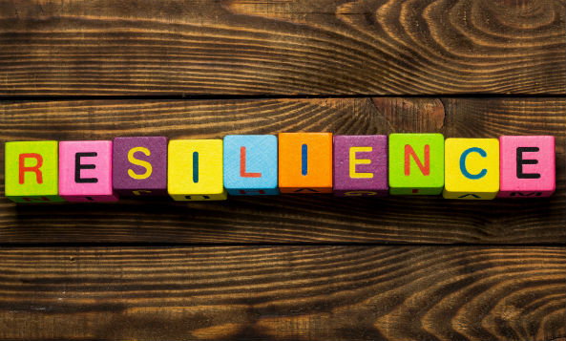

Slide 6
Resilience
“Is the capacity to remain flexible in our thoughts, feelings, and behaviours when faced by a life disruption, or extended periods of pressure, so that we emerge from difficulty stronger, wiser and more able.” (Carole Pemberton)

Slide 7
Creating the right Culture
Physical & Psychological Safety
Meaning and Purpose
Choice and Autonomy
Camaraderie and Teamwork
Fairness and Equity

Slide 10
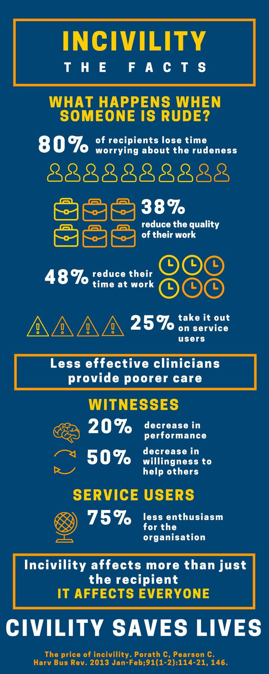

Slide 12
10 Steps to Wellbeing
Eat well & hydrate
Sleep
Exercise
Be willing to face reality with a sense of realistic optimism
Recognise what you do and do not have control over
Seek support
Learn about simple meditation techniques
Create meaning
Write about it
Do something that takes you away from the issue
(Southwick & Charney)

Slide 13
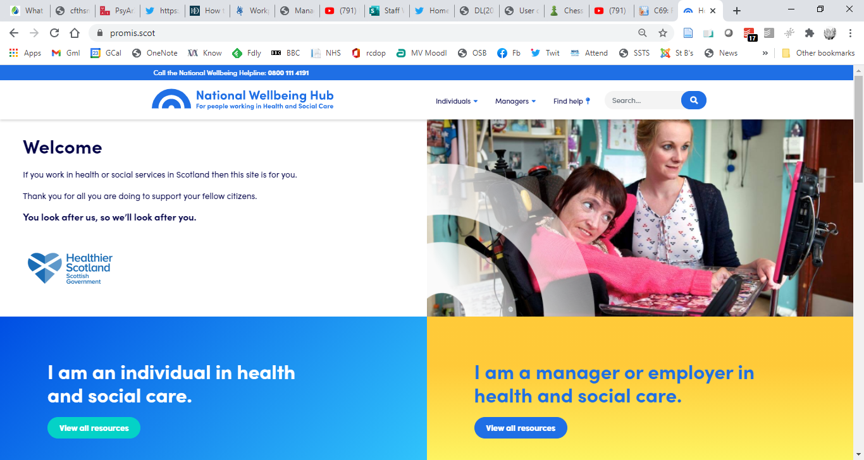

Slide 14
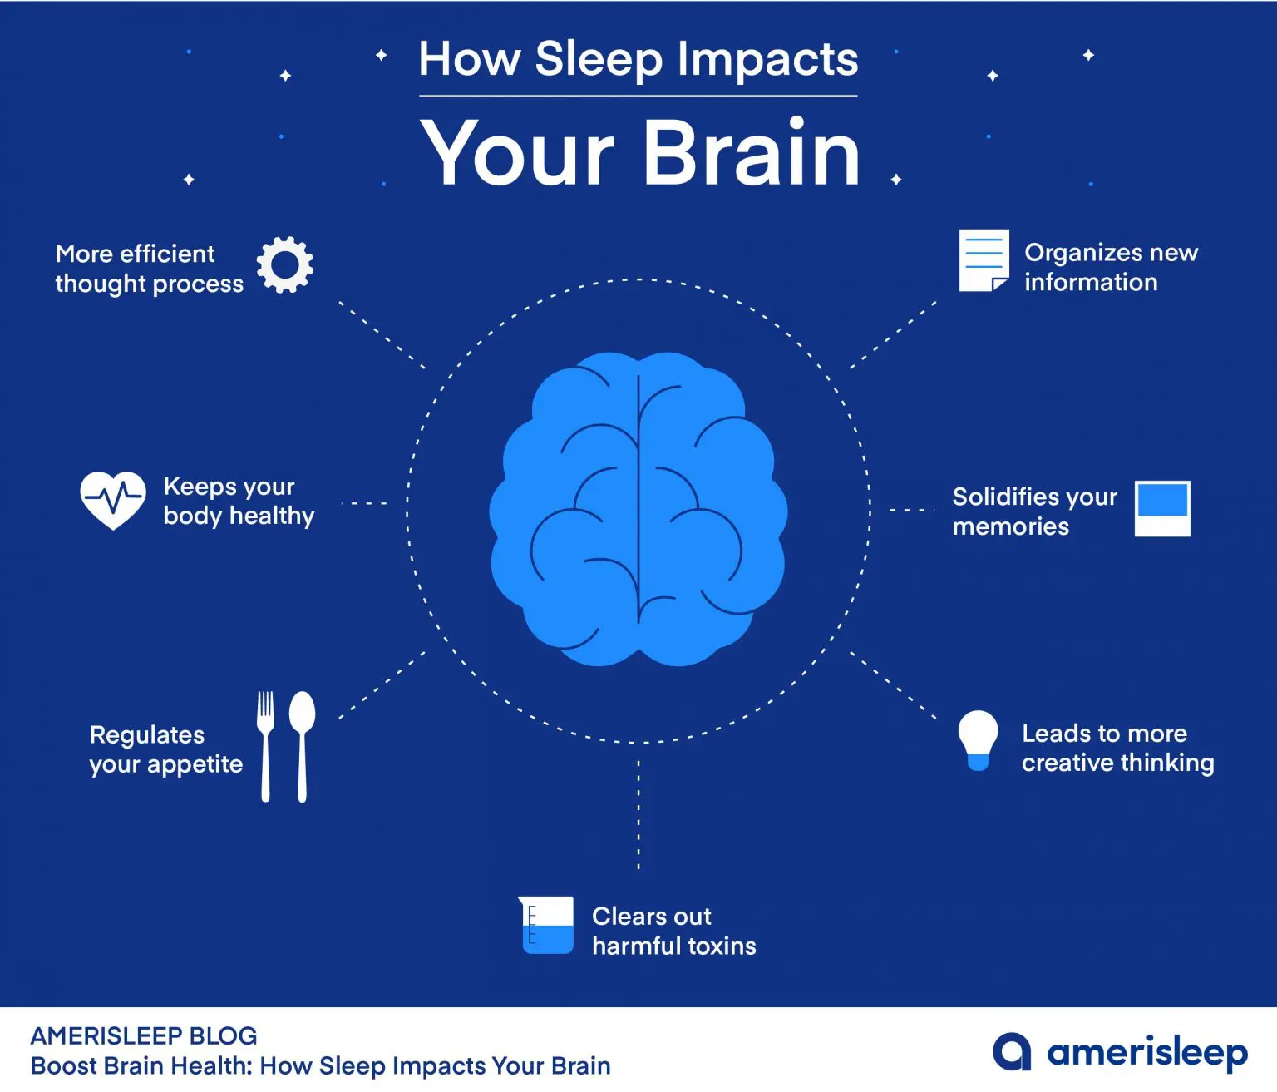

Slide 15
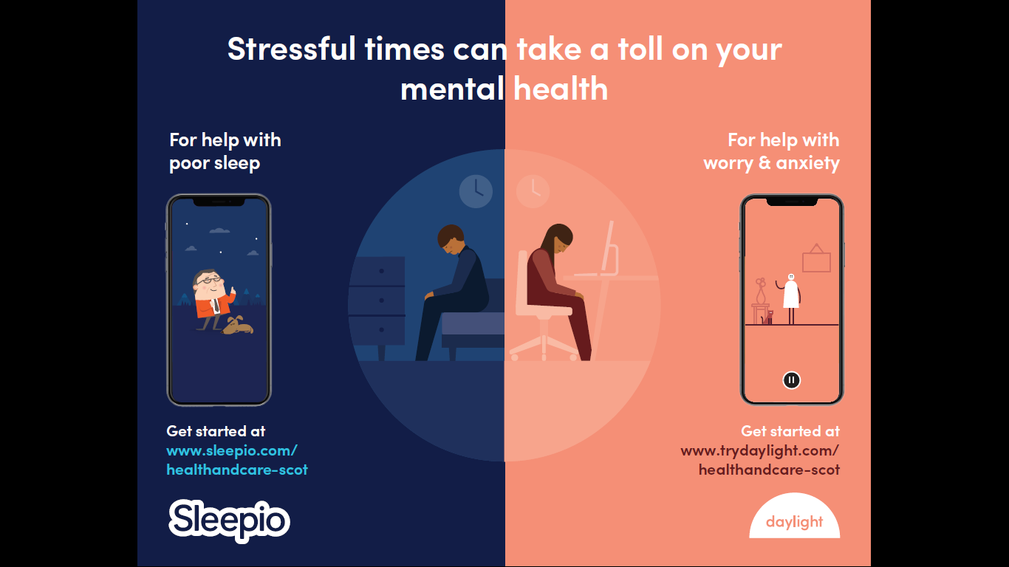

Slide 16
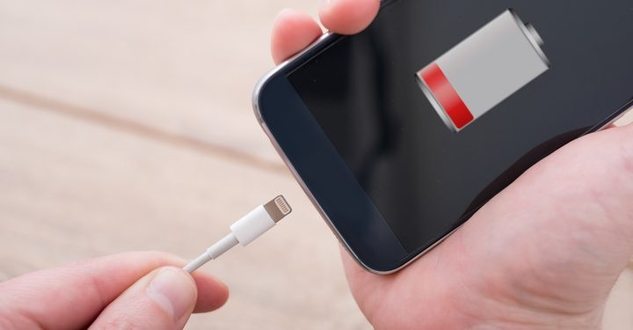

Slide 17
