Slide 1
It’s Ok Not To Be Ok
Ray de Souza, National Wellbeing Adviser
Vikki Bruce, Staff Wellbeing Unit, SG Health Workforce Directorate

Slide 2
Objectives
To take a moment to consider our mental health and wellbeing and what we will do keep ourselves safe over the coming months.
To raise awareness of resources to promote good mental health and wellbeing.

Slide 3
Firstly, Thank You
Huge impact of pandemic on GP Practices
Teams in GP Practices are doing amazing work

Slide 5
Looking After You: Take Care Of The Basics
Take regular breaks, and try to keep moving.
Allow time for sleep, rest and respite between shifts.
Try and stay as connected to your friends and family as much as possible via technology.
Maintain, where possible, your normal daily routine and a healthy diet, and get fresh air when you can.
Avoid using unhelpful coping strategies that involve alcohol, tobacco or an unhealthy diet.
Think about creating a consistent routine to ensure you get the amount of sleep you need, but also about ensuring your bedroom is quiet, dark and a relaxing environment to sleep in.

Slide 6
Look After Each Other
Speak to colleagues. They may be feeling the same way. It’s good to talk.
Peer and social support are often the best buffers against stress and adversity.
Look out for each other and share small successes about what’s gone well.
Be kind to each other. This can have a profound impact on wellbeing.
Leave work in work.
Make sure you give yourself space to process the events of the day and deal with your feelings.

Slide 7
Going Home Check List
Take a moment to think about your day
Acknowledge one thing that was difficult about your working day - Let it go
Consider three things that went well
Check on your colleagues before you leave – are they ok?
Are you ok – We are here to support you
Now switch your attention to home – Rest and recharge
Mindfulness Mental Health

Slide 8
Local resources
Local Health Board resources such as staff wellbeing ‘hubs’, listening services, peer support, digital offerings and Occupational Health – available to GPs, practice nurses and GP practice staff, as well as wider NHS and social care staff.
Workforce Wellbeing “Champions” – each Health Board, local authority and Health and Social Care Partnership has been asked to nominate a “Champion” for promoting staff wellbeing across their organisation and co-producing national activity to support staff.

Slide 9
National resources
Four complementing and interlinking components:
National Wellbeing Hub (www.promis.scot)– digital resources
National wellbeing helpline for HSC staff (0800 111 4191)
Additional funding to Boards for psychological therapies + interventions
Workforce Specialist Service
This will support staff working across public services as well as the independent and third sectors, building on local staff wellbeing arrangements.

Slide 10
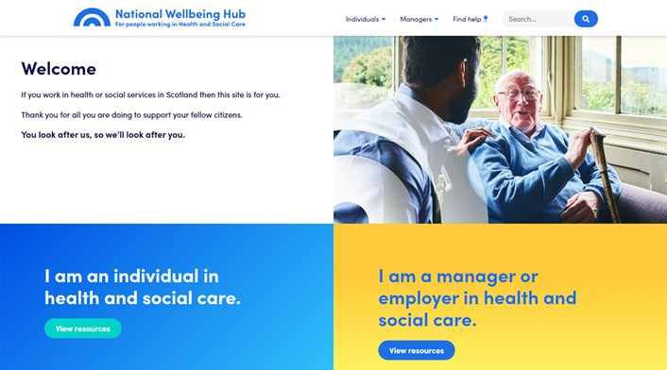
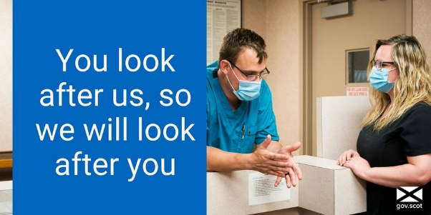
National Wellbeing Hub - www.promis.scot
The Hub signposts Health and Social Care staff, unpaid carers, volunteers and their families to relevant services, and provides a range of resources designed to support the workforce as they respond to the impacts of Covid-19.
The Hub offers:
advice and evidence-based digital resources to help staff cope with issues such as stress, anxiety and resilience, and improve sleep;
“Coaching for Wellbeing”, a digital coaching service for all health and social care staff; and
a map signposting visitors to wellbeing support services in their areas, and a dedicated page for unpaid carers addresses their specific needs.
Over 64,000 users to date; seeking support with self care/coping; average increase of 1200 p.w. c. 41% NHS; 31% social care.
New webinar programme for Jan-March
Changes to content: More use of film clips, what’s new, podcasts; new topics (Alcohol, Vaccinations etc.)

Slide 11
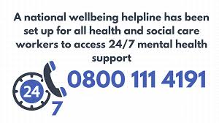
National Wellbeing Helpline - 0800 111 4191
24/7 support to the health and social care workforce provided by psychological wellbeing practitioners within NHS 24’s Mental Health Hub.
Trained ‘psychological wellbeing practitioners’ (PWPs) at NHS 24 offer callers a compassionate and empathic listening service based on the principles of psychological first aid.
The PWPs also offer advice, signposting and onward referral to local staff support services if required (and arrangements in place for staff to be seen outwith their employing Board if they prefer).

Slide 12
Additional funding to Boards
Funding for Boards for a workforce development programme to increase Boards’ capacity to deliver psychological interventions and therapies to support the mental health and wellbeing of health and social care workforce.
Boards may also use the resource to fund impactful additional measures to support staff mental health and wellbeing across the stepped care response.
Boards are employing a range of staff - Clinical Psychologists; Applied Psychologists/Therapists/Counsellors; and support staff (e.g. Assistant Psychologists/Admin).

Slide 13
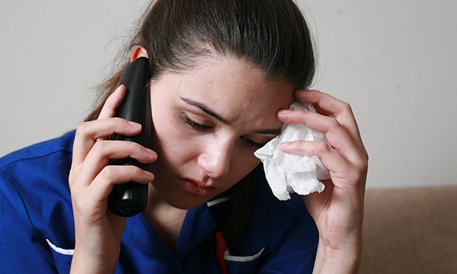
Workforce Specialist Service
Specialism in confidential mental health and addictions treatment and support to regulated staff who:
experience difficulty accessing confidential assessment and treatment for mental health; and
are often reluctant to seek help due to concerns about professional implications (e.g. regulator involvement).
First phase of delivery through NHS Practitioner Health in early 2021 – available to GPs, nurses and AHPs.
Continuing to engage with Health Boards on options for the stand-alone WSS, which will be mobilised over the course of 2021.

Slide 14
Questions/issues to explore
How can you look after your wellbeing and keep yourselves safe?
How can you help your colleagues to look after their wellbeing and keep themselves safe? Discussion with Practice team?
How can you stay connected and take advantage of resources?
What more would help in terms of additional local or national support?

Slide 15
It’s OK not to feel OK, so please access help and support when you need it.
www.promis.scot
0800 111 4191

